Slide 1
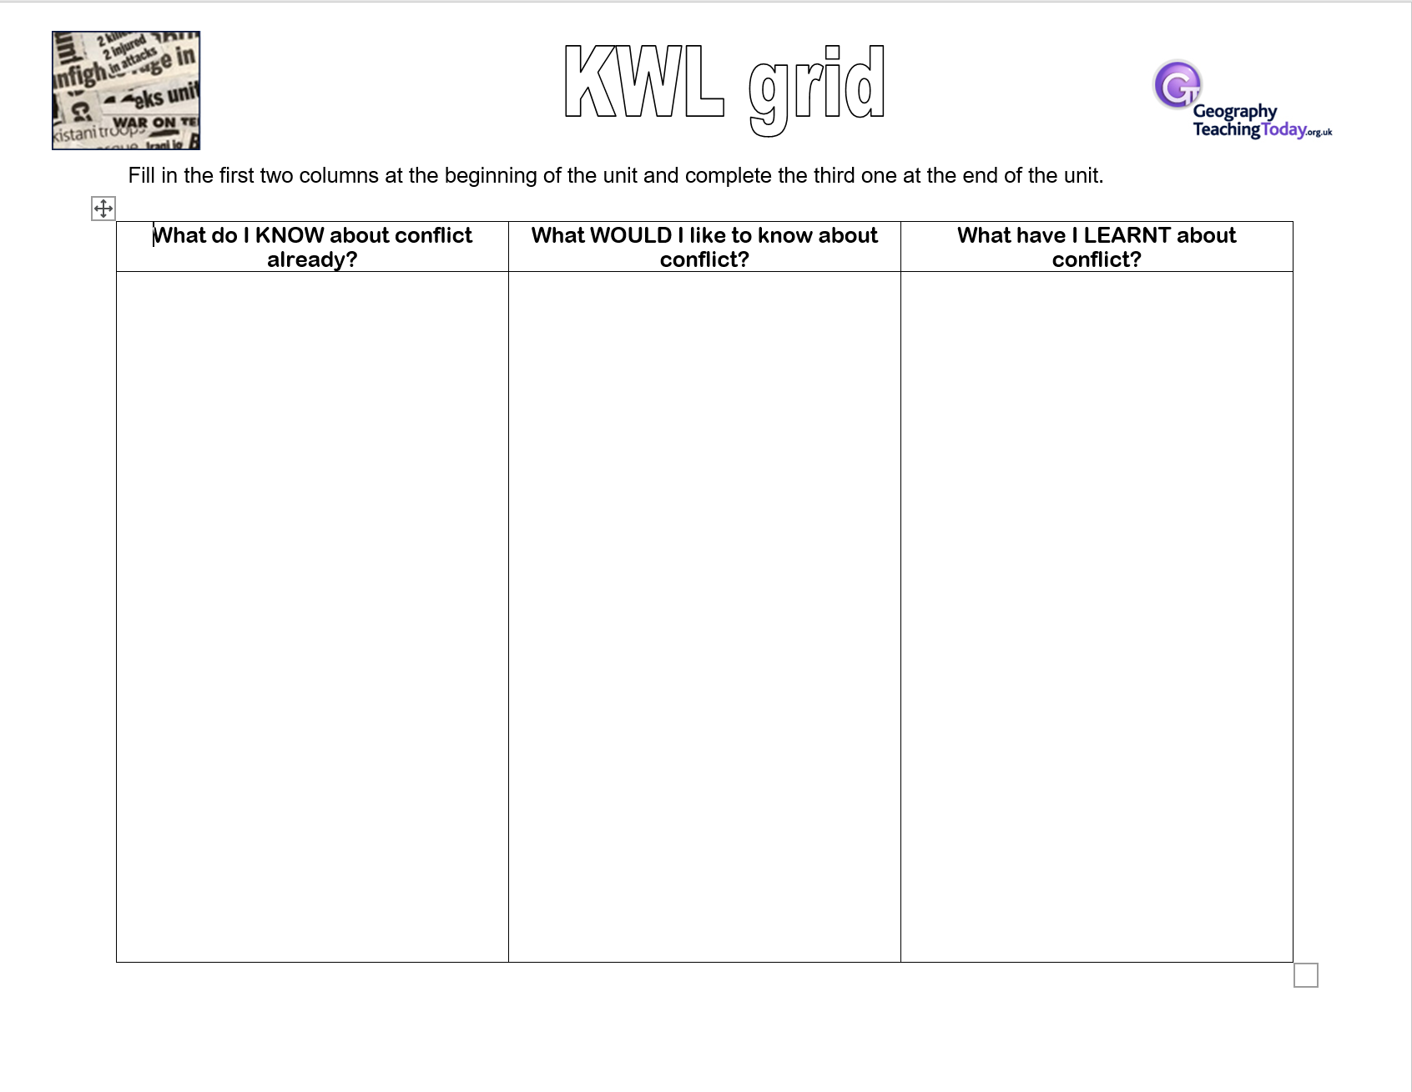
Starter
Complete the first two columns – What do I KNOW about conflict? and What WOULD I like to know about conflict?
Leave the last column
Resources throughout this unit are from Teach it Geography, Connections, Hodder and various other places.
Notes:
Last column will get revisted at the end of the unit

Slide 2
?
Enquiry Question: How does Geography influence conflict?
Success criteria
To be able to define conflict
To be able to
AO5: To be able to communicate well
Resources throughout this unit are from Teach it Geography, Connections, Hodder and various other places.

Slide 3
Application
Can you write your own definitions for the following terms:
Conflict
War

Slide 4
Feedback
Conflict is…
Conflict is a state of discord caused by the actual or perceived opposition of needs, values and interests.
Source: http://en.wikipedia.org/wiki/Conflict
War is…
A conflict among political groups involving hostilities of considerable duration and magnitude.
Source: http://www.britannica.com/
Do these differ to your definitions?
U.S. Air Force photo by Staff Sgt. Dennis J. Henry Jr. and licensed for reuse under Creative Commons Licence.
Notes:
Teacher discuss the students differences

Slide 5
Input
We are going to investigate the topical issue of conflict, a concept that can be has challenges because its not simple and everyone has an opnion as to the causes of conflict.
We are going to focus on the enquiry question “how does Geography influence conflict?” Through studying historical and contemporary conflicts on a range of scales in order for you to be able to discuss this enquiry question further and maybe come up with an answer ……. Or not! Just more question….! Who knows!

Slide 6
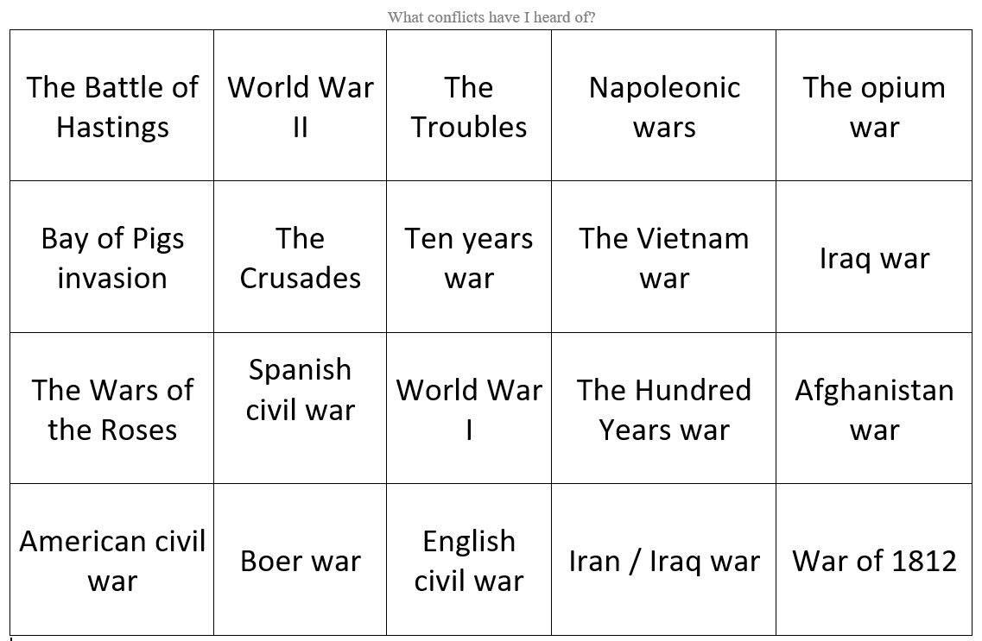
Application
On your worksheet you will see the names of some conflicts that have occurred over time.
Put a green circle in the top right hand corner for the conflicts you have heard of
Put a red circle in the top right hand corer for the conflicts you have not heard of
What do you need to add to you worksheet?
KEY
Notes:
Student will be adding the the card sort so please do not allow them to colour the whole box
Discuss with students what they have got

Slide 7
History cross curricular – This is where the students have covered these wars in KS3
Up dated Summer 2020
The Battle of Hastings - Y7
The Crusades - Y7
The Hundred Years war - no
The Wars of the Roses- Tudors Y7
English civil war - Y8
Napoleonic wars- briefly in Y7
War of 1812 - no
Spanish civil war KS4
The opium war - Y8
American civil war - Y8/9
Ten years war -no
Boer war - Y8
World War I -Y9
World War II -Y9
The Vietnam war - only in reference to Cold War Y9/Y10
Bay of Pigs invasion - Cold War Yr 9 /10
The Troubles - No but might be we are rejigging some of curriculum
Iran / Iraq war
Afghanistan war
Iraq war
18-20 we cover in an introduction to Y9 on war and conflict
Ps. Treaty of Versailles in Y9- Settlement of WW1

Slide 8
Application
On your worksheet you will see the names of some conflicts that have occurred over time.
Use your chrome books to work out where and when these conflicts took place
Put a Orange circle in the top left hand corner for the conflicts that are local (to Norton)
Put a red circle in the top left hand corner for the conflicts that are national (UK within the UK or UK v 1 other country)
Put a blue circle in the top left hand corner for the conflicts that are global (conflicts outside UK)
Write the dates in the boxes
Notes:
The wars of roses – explain it was local because it was between two counties

Slide 9
Feedback
Key
Local
National
Global
Notes:
Discussion needed re the global wars are not World wars but wars that took place outside the UK

Slide 10
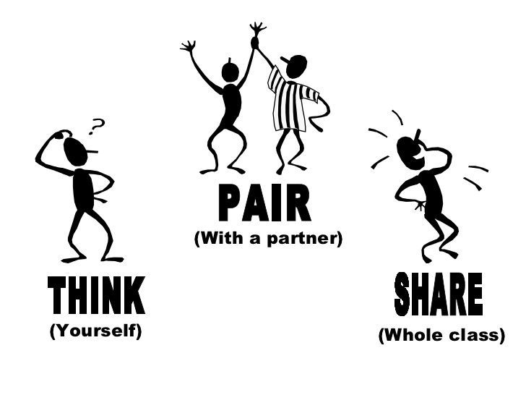
Application
We have identified which of these conflicts we have heard of and what scale they were from local, national through to Global.
What else could we do with the data we have found?

Slide 11
Feedback
Map the data
Put into chronological order

Slide 12
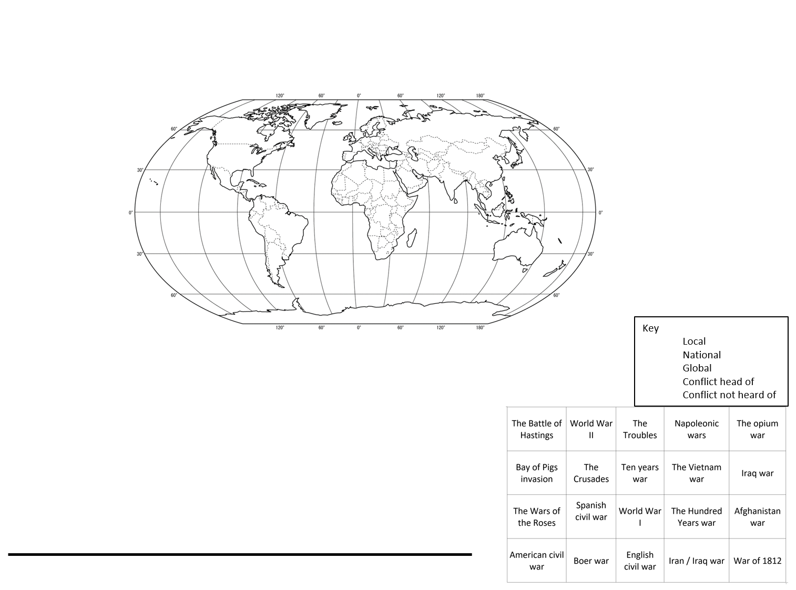
Application
In History you draw timelines or chronological lines to order historical events, we do the same in Geography.
On worksheet under your map, on the line drawn for you add the conflicts in chronological order
Time line

Slide 13
Feedback
Time line
The Battle of Hastings 1066
The Crusades 1096 - 1291
The Hundred Years war 1337 - 1437
The Wars of the Roses 1455 - 1485
English civil war 1642 – 1651
Napoleonic wars 1803 - 1815
War of 1812 1812 - 1815
The Opium war 1839 - 1860
American civil war 1861 - 1865
Ten years war 1868 - 1878
Spanish civil war 1898 – 1898
Boer war 1899 - 1902
World War I 1914 - 1918
World War II 1939 - 1945
The Vietnam war 1955 - 1975
Bay of Pigs invasion 1961
The Troubles 1968 - 1998
Iran / Iraq war 1980 - 1988
Afghanistan war 2001 – 2014
Iraq war 2003 - 2011

Slide 14
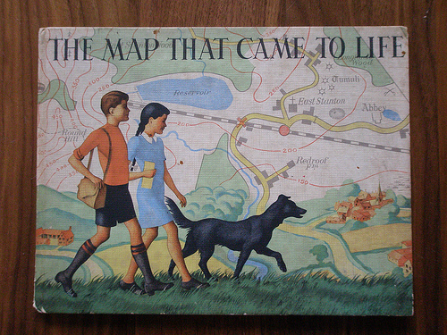
Input
Modelling a map
“Maps are a powerful way of thinking about the earth”
from Making maps: A visual guide to Map Design for GIS – Krygier and Wood (2005)
The Map that Came to Life by Flickr user I like and licensed
for reuse under the Creative Commons licence.
Think carefully about what you want your map to show - remember you can use colour and / or symbols to show different things.
The best maps show the information in a clear way – do not let your map get too cluttered and complicated.
If your map has not got a title and a key then it is not a good map.
You can always create inserts where you zoom into parts of your map if the distribution is uneven.

Slide 15
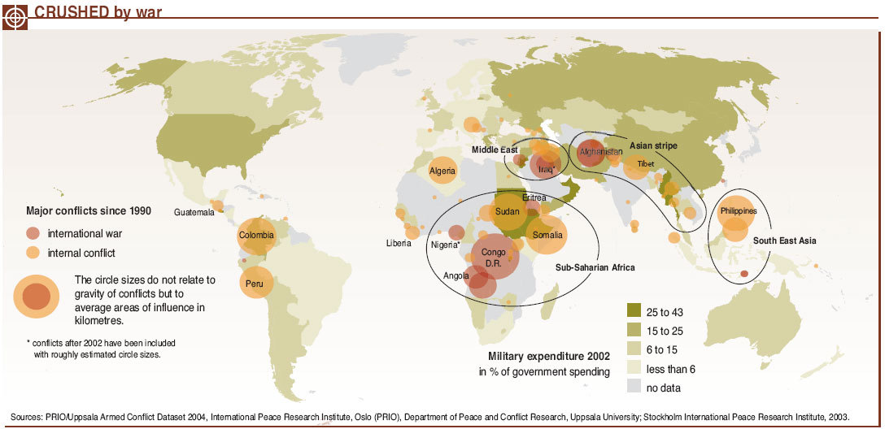
Application
Is this a 'good' map?
Crushed by war – world conflicts (2005). In UNEP/GRID-Arendal Maps and Graphics Library. Retrieved 14.55, February 11, 2009 from
http://maps.grida.no/go/graphic/crushed-by-war-world-conflicts. Map credit Emmanuelle Boumay.
Suggest 3 things which are good about this map and 3 things which could be improved.

Slide 16
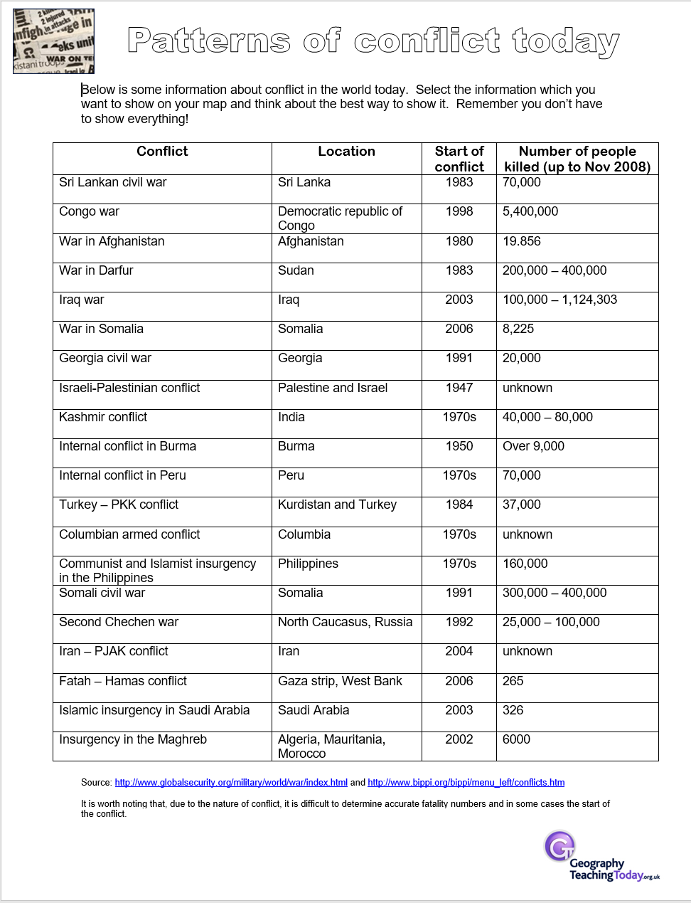
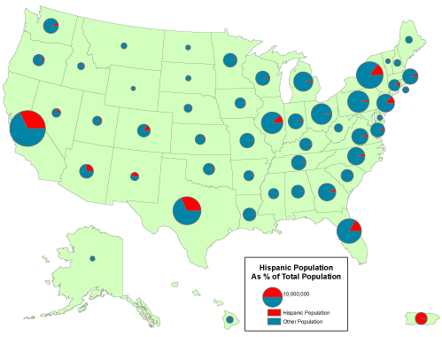
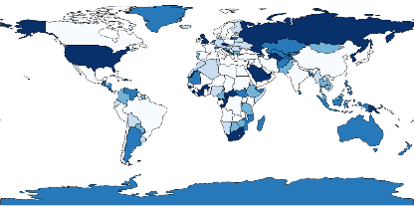
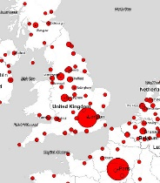
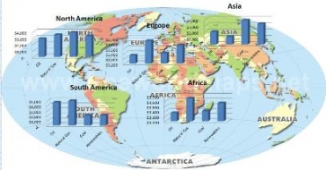
Application
Use the information from the ‘patterns of conflict today’ sheet to design and create your own map illustrating the pattern of conflict in the world today.

Slide 17
Application
Describe the pattern of conflict in the world today as shown on your map
T – trend / pattern - What is the general pattern showing? To use information from your map, such as continents, countries, oceans, compass directions
R- range – what is the different between he smallest and highest – this will depend on the data you have used for example – dates or number of people killed
A – anomaly – is there a location that does not fit the normal pattern – an outlier
S – smallest – what is your smallest data – this will depend on the data you have displayed – for example the earliest year or the conflict with the smallest number of deaths
H – highest – what is your highest data – this will depend on the data you have displayed – for example the latest year or the conflict with the highest number of deaths

Slide 18
Pattern of conflict data – printed in the office, please return as soon as you have finished with it

