Slide 1
“In the field”
“Ice River – A journey to Zanskar in Winter

Slide 2
What challenges did the researchers face and what equipment did they need.

Slide 3
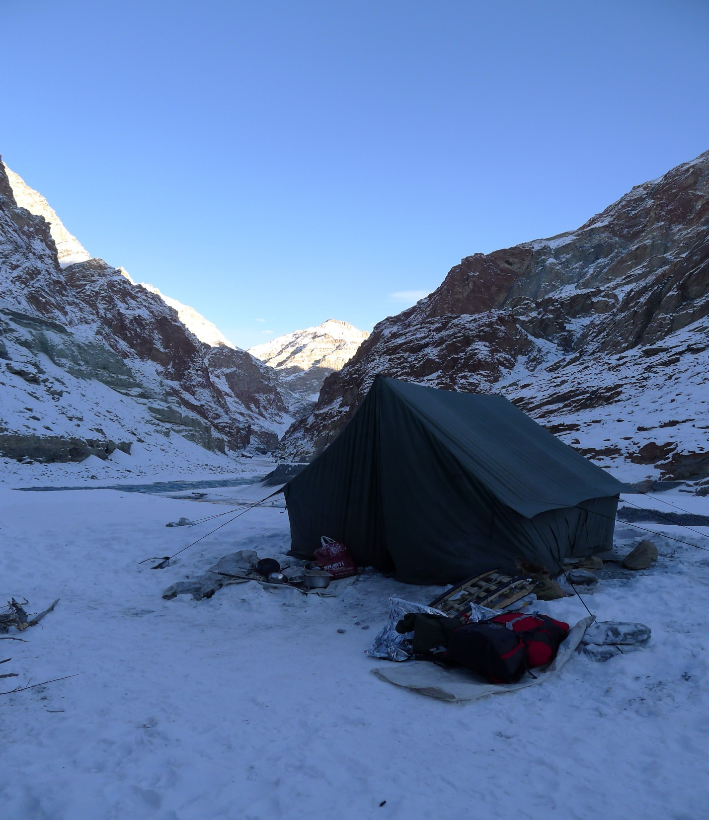

Slide 4
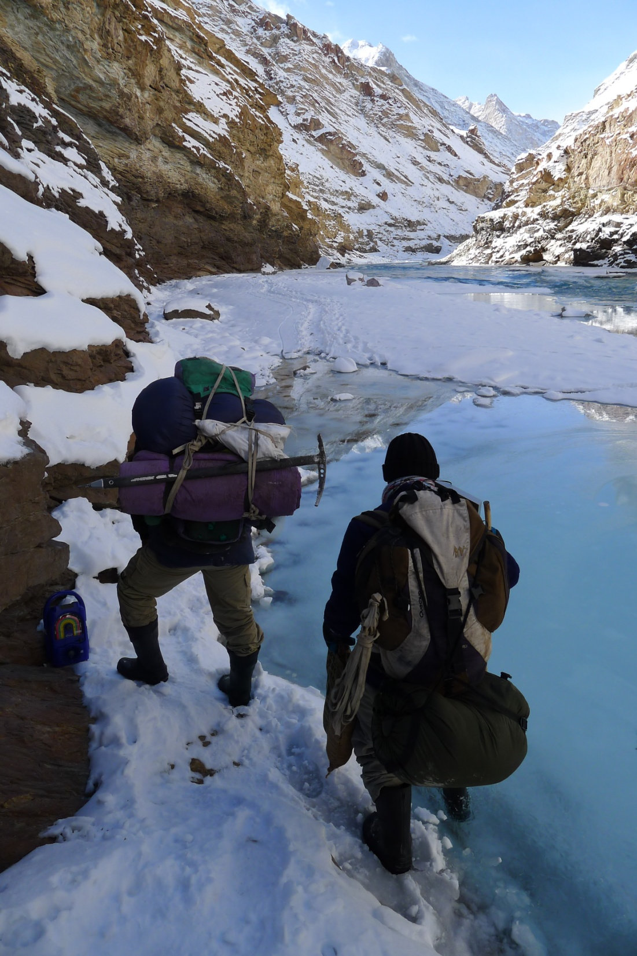

Slide 5
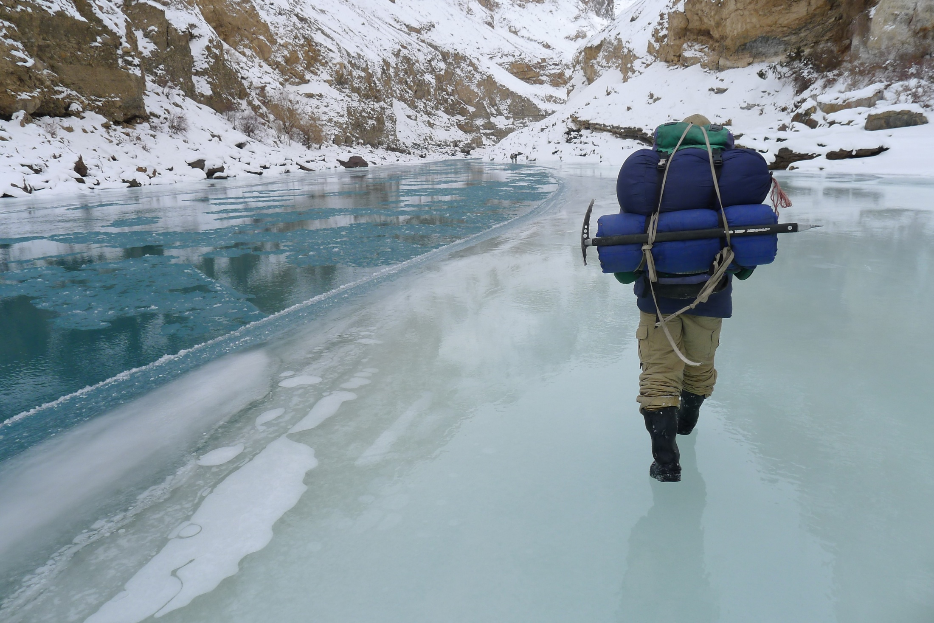

Slide 6
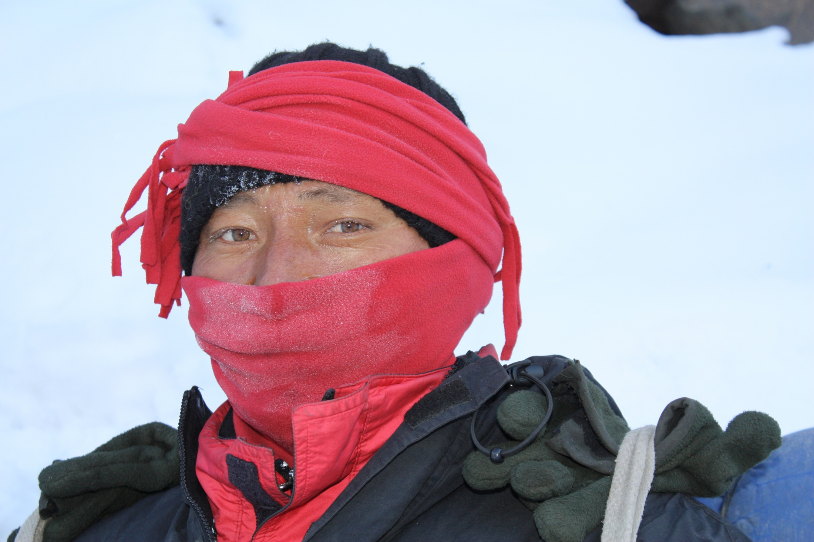

Slide 7
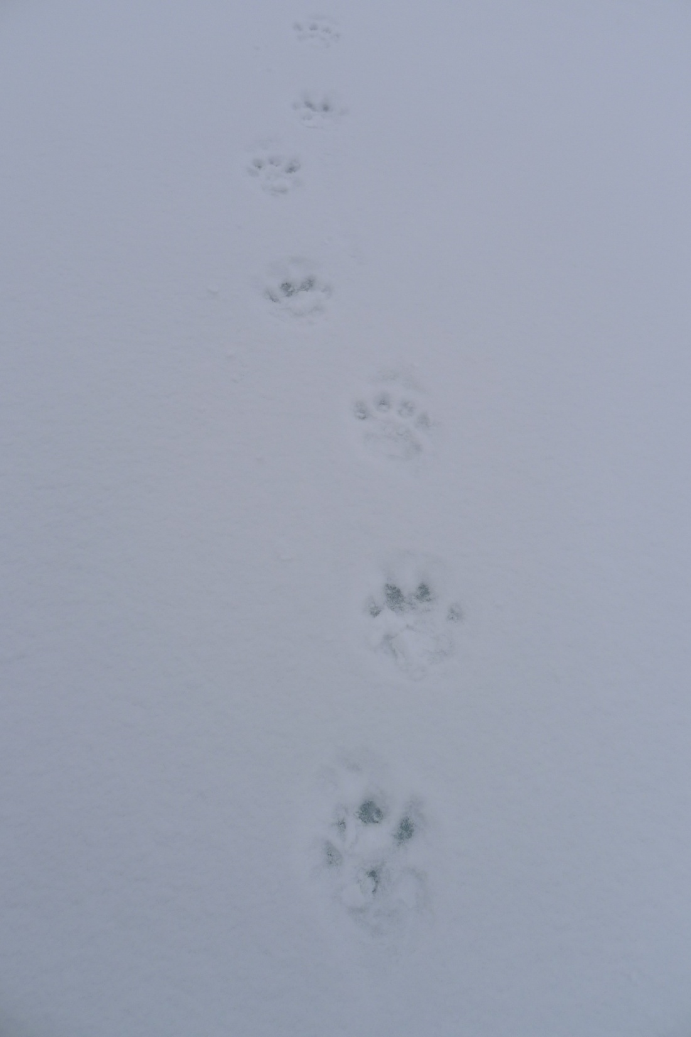

Slide 8
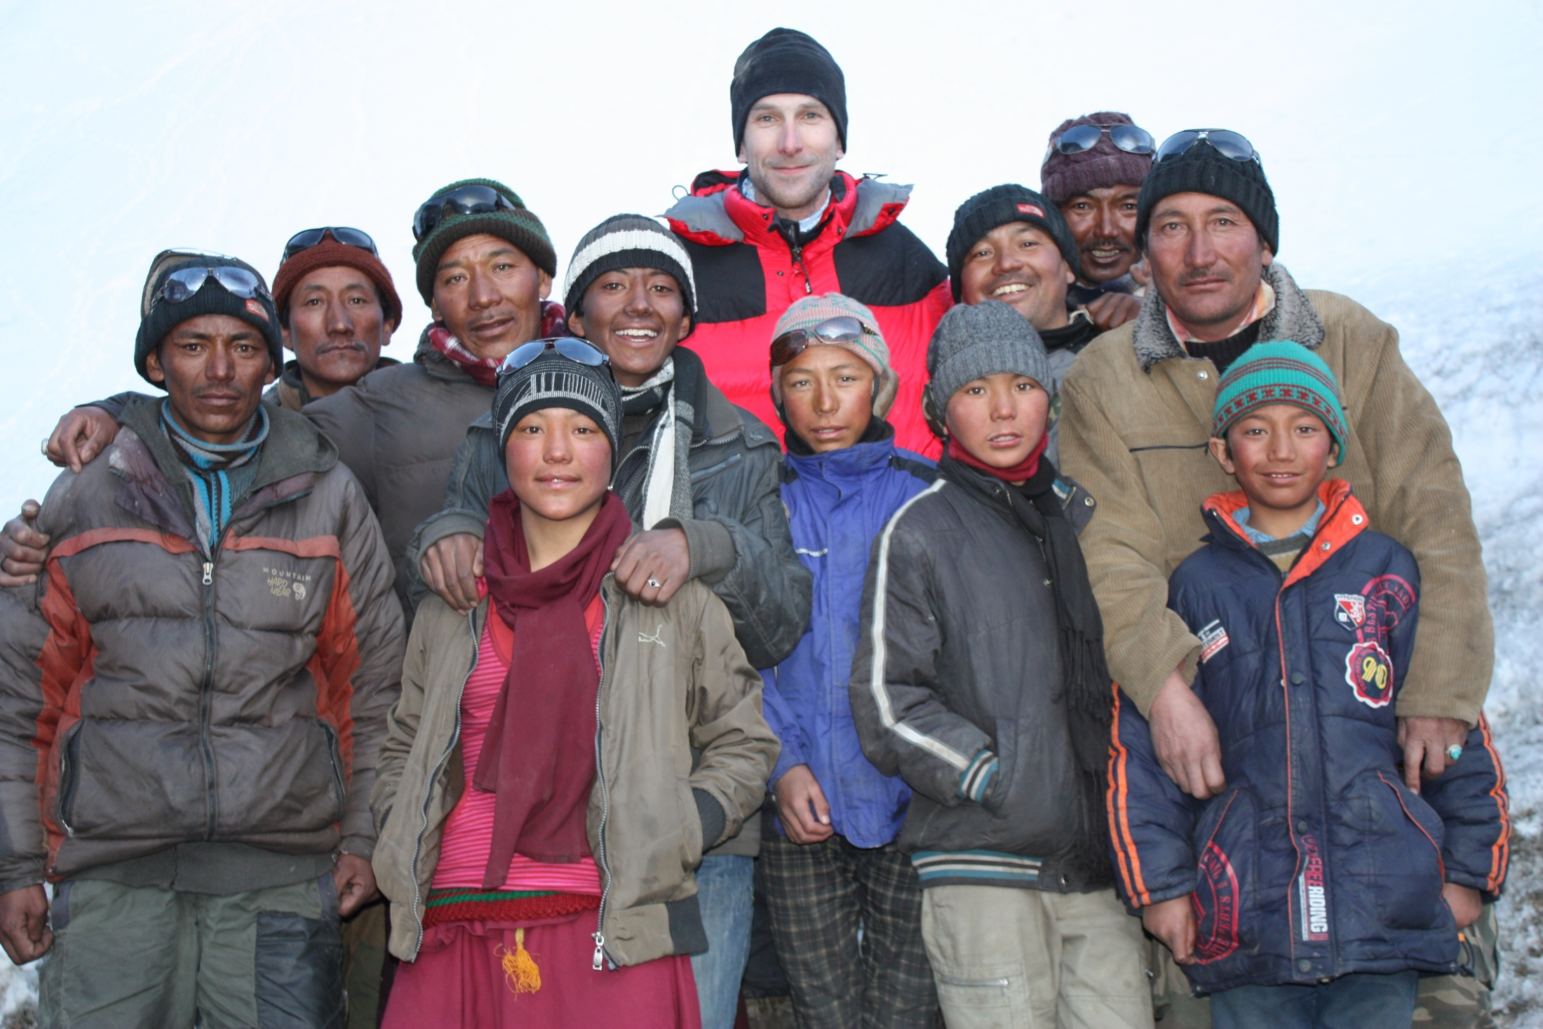

Slide 10
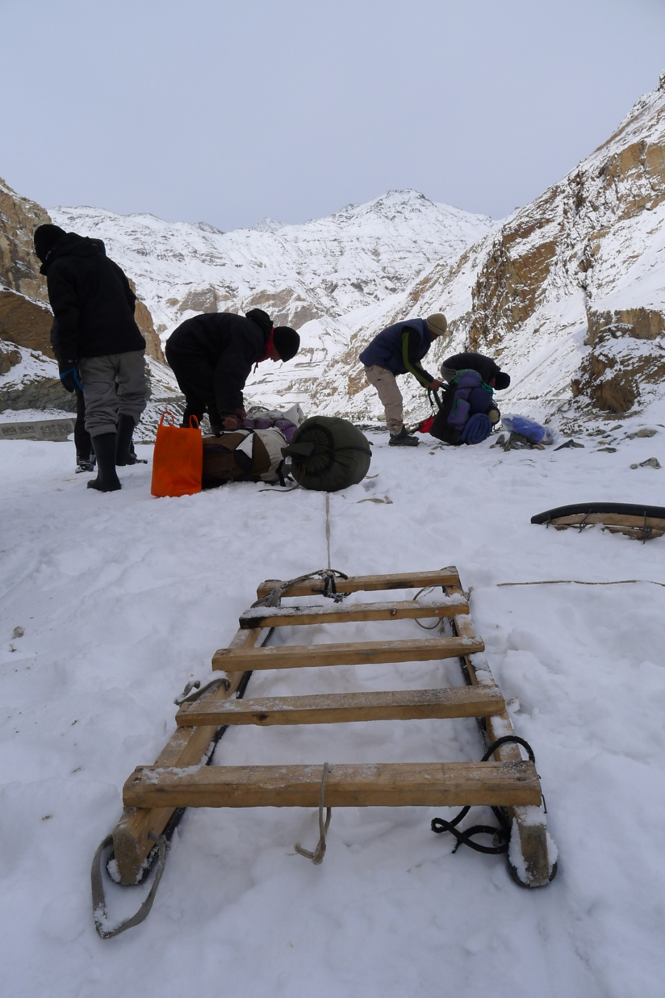

Slide 11
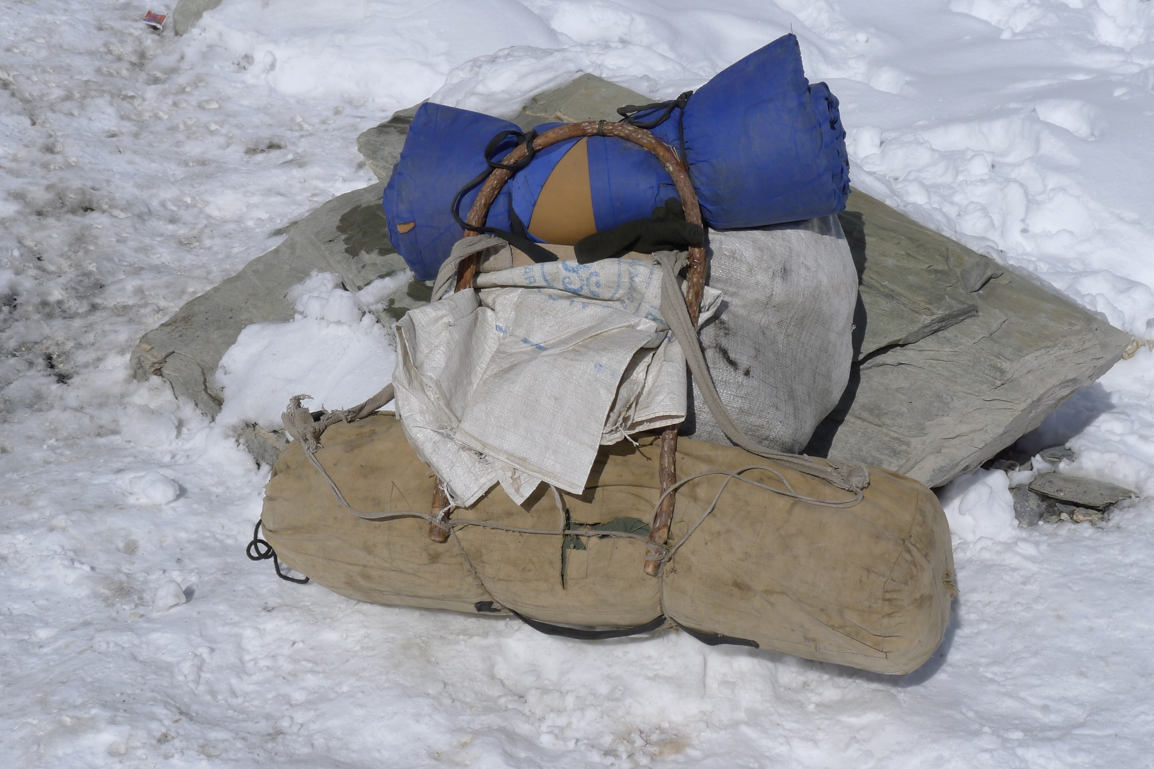

Slide 12
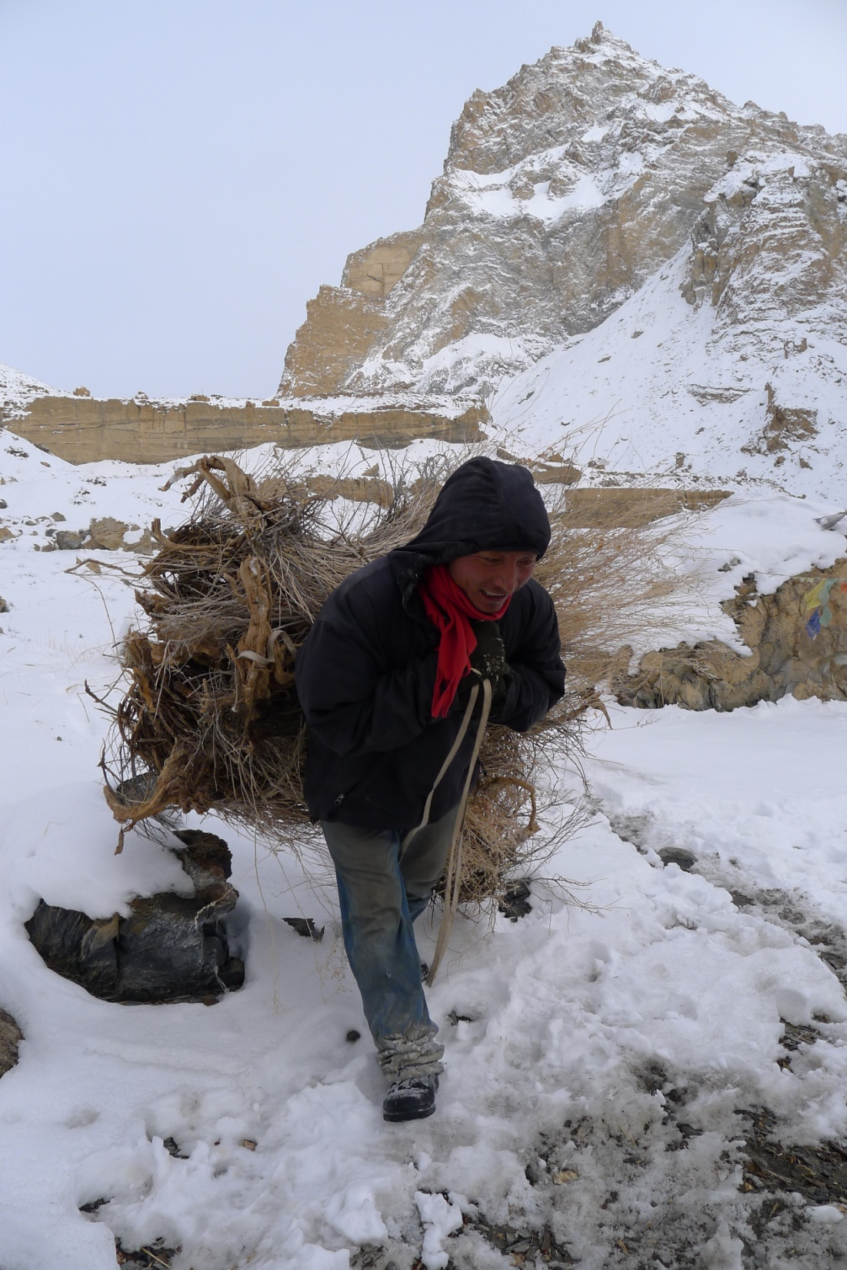

Slide 13
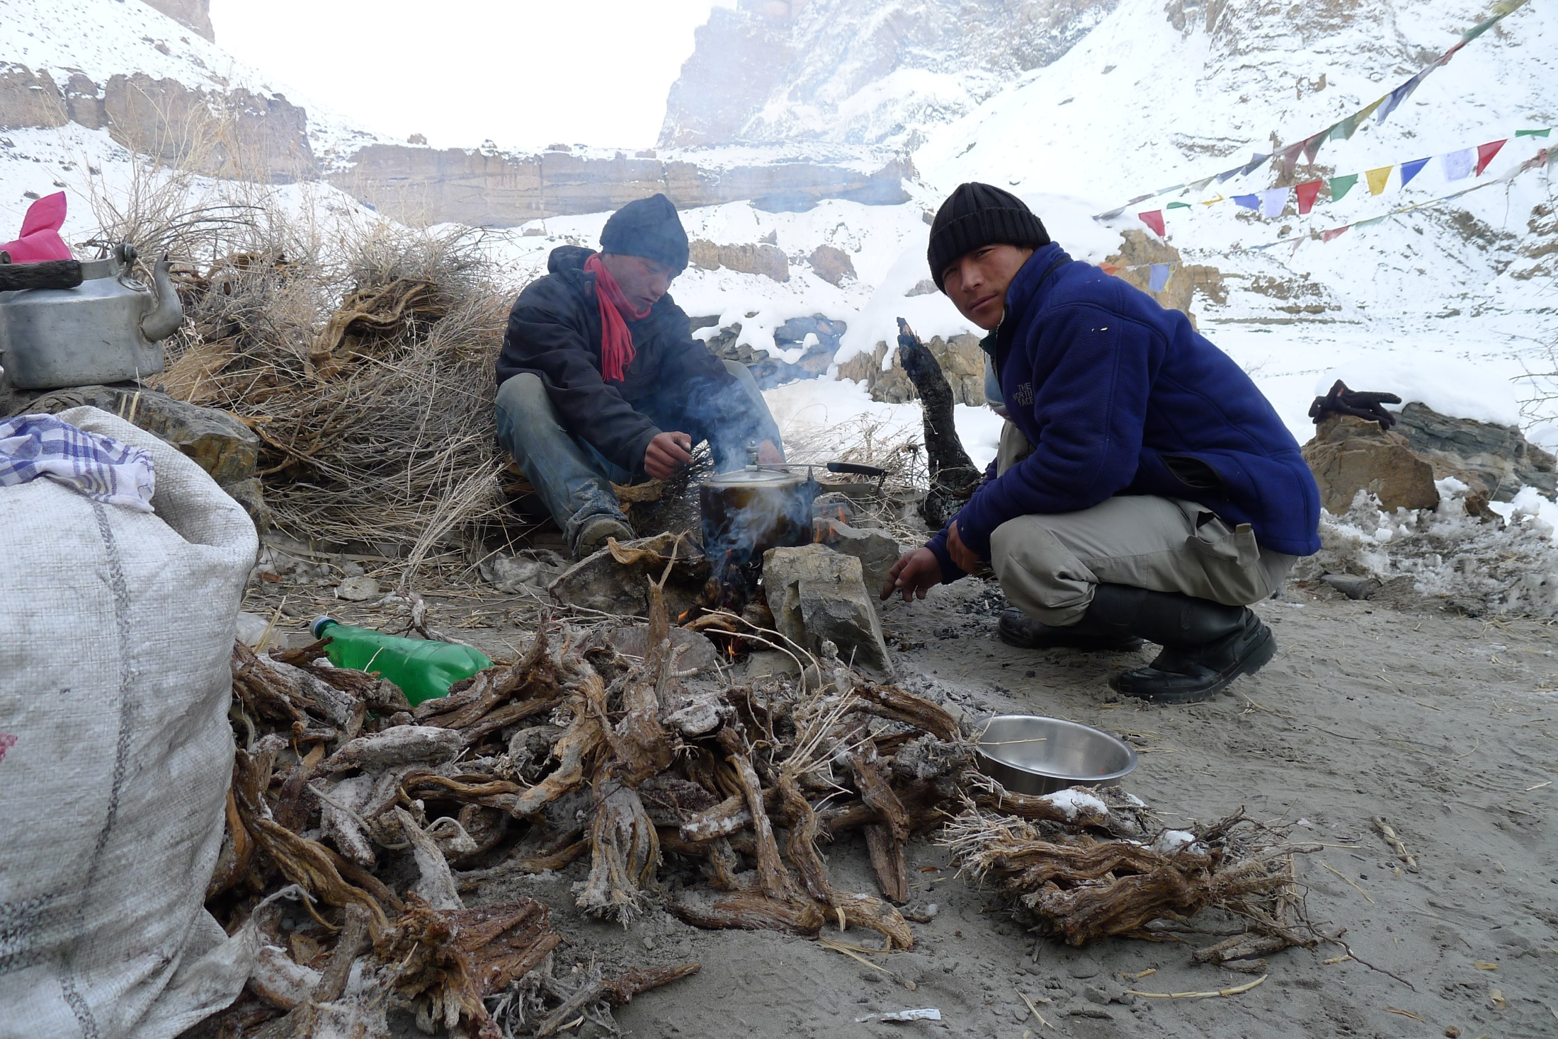

Slide 14
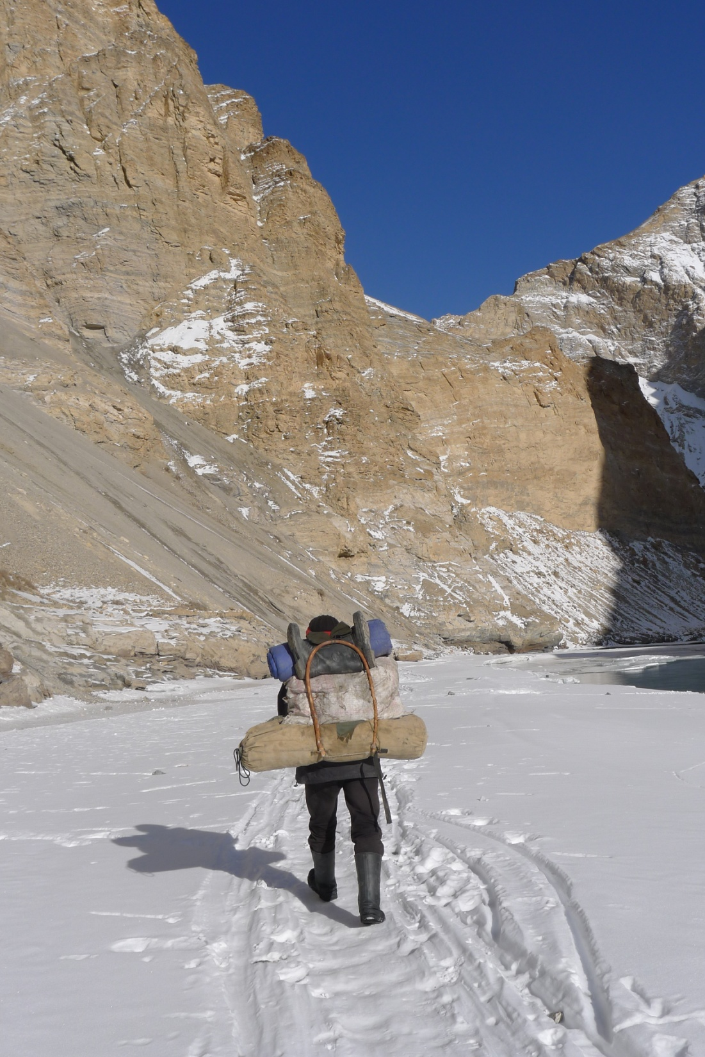

Slide 15
With thanks to .....
Paul Howard and Tanzin Norbu for the photographs and audio footage.

