Slide 1
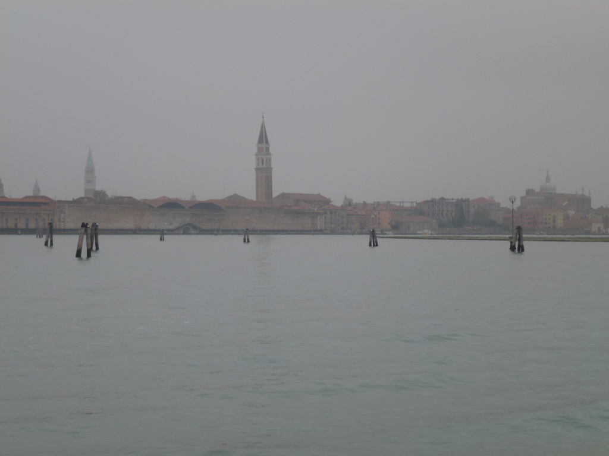
Illustrating the historic city, lagoon city, and mainland
Lesson one
population, demographic change, and tourism
View of Venice © David Anderson

Slide 2
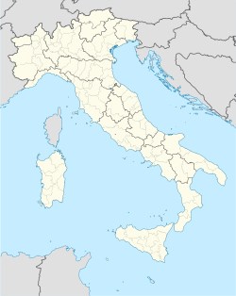
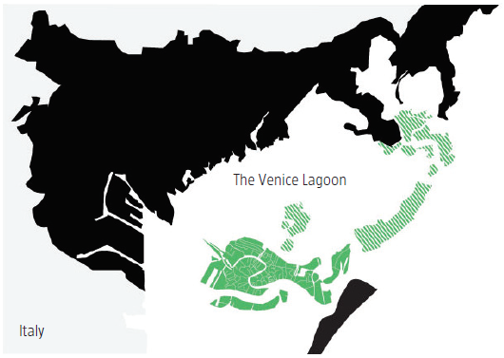
The municipality of Venice includes the historic city, other islands of the lagoon, and mainland bordering the lagoon.
Map of Italy © Wikimedia Commons
Source: The Venice Report 2009

Slide 3
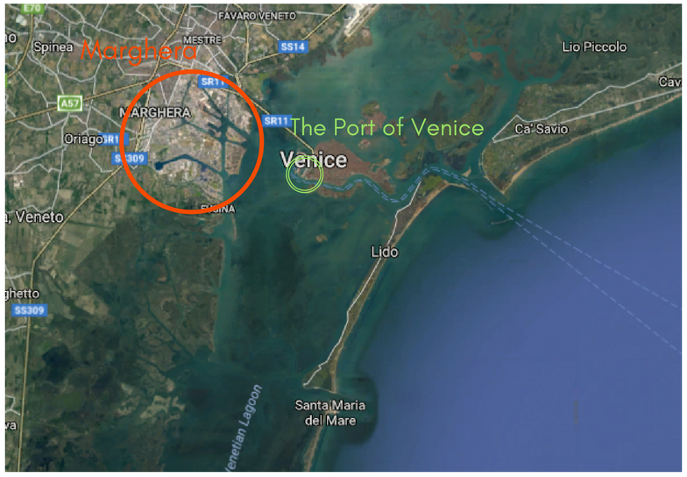
The lagoon of Venice and location of the Port of Venice
© Google Maps

Slide 4
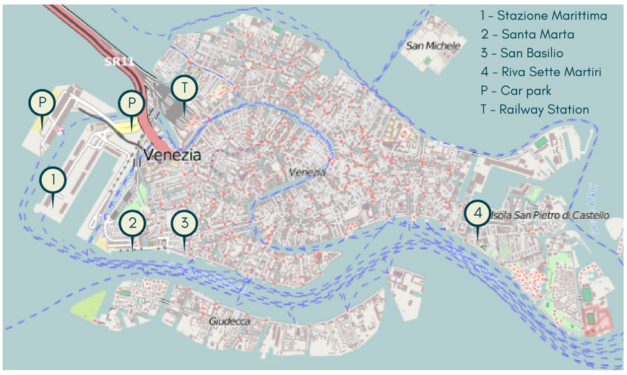
The historic city is accessed by a causeway connecting it to the mainland by road and rail, and there is a cruise ship terminal (marked 1 on this map) operated by the Port of Venice. Water buses and water taxis also cross to and from the mainland.
Port of Venice © Bourrichon, Wikimedia Commons

Slide 5
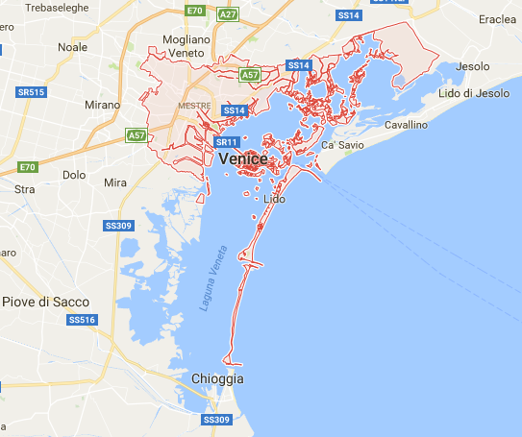
Image from Google Maps showing the location of the historic city and the larger mainland settlement of Mestre in the Venice Municipality
Marghera
port
Three inlets between the
Adriatic Sea and the lagoon of
Venice.
© Google Maps

Slide 6
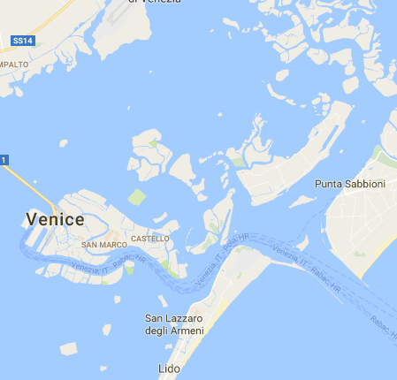
Image from Google Maps showing the historic city and other islands in the northern part of the lagoon of Venice
Torcello
(famous for its basilica church)
Venice airport
Murano
(famous for glass making)
Sant’Erasmo
Lido
Lido inlet
© Google Maps

Slide 7
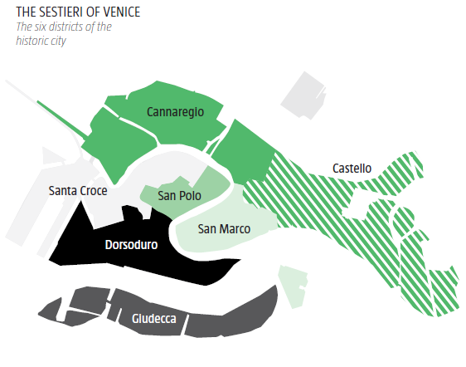
Demographic data for the historic city can be compared across its six districts.
Rialto Bridge
Grand Canal
Source: The Venice Report 2009

Slide 8
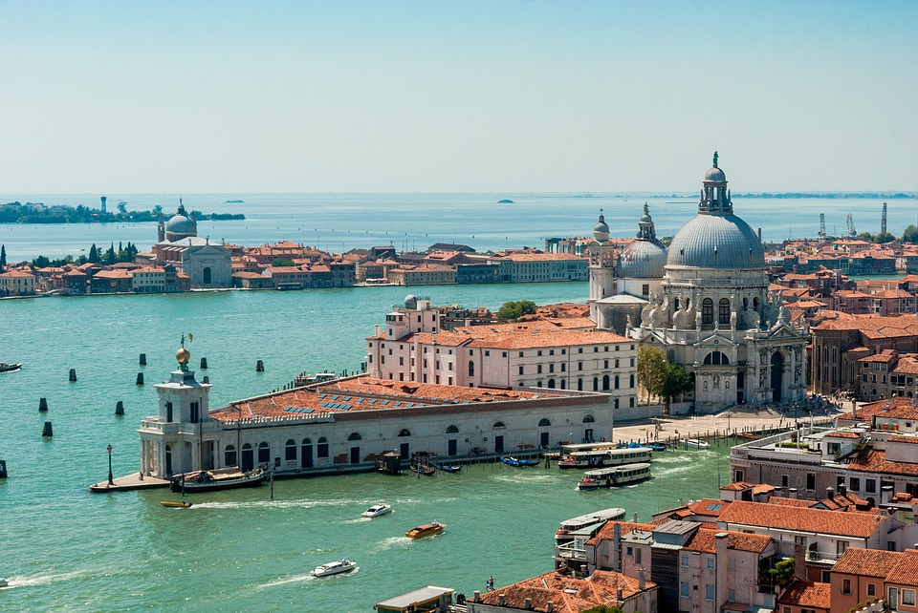
View looking southwards, tip of Dorsoduro and end of the Grand Canal in the foreground, Giudecca in the background
Looking southwards from Venice © Jarek Grafik, Pixabay

Slide 9
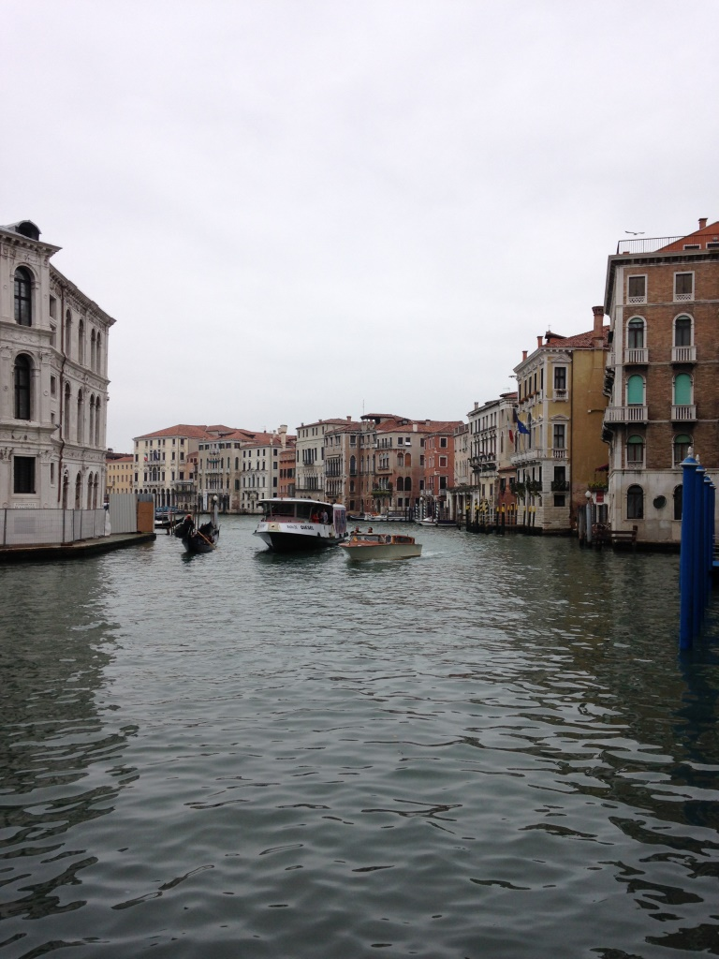
A view looking up the Grand Canal from Rialto Bridge in the historic city
Grand Canal from Rialto Bridge © David Anderson

Slide 10
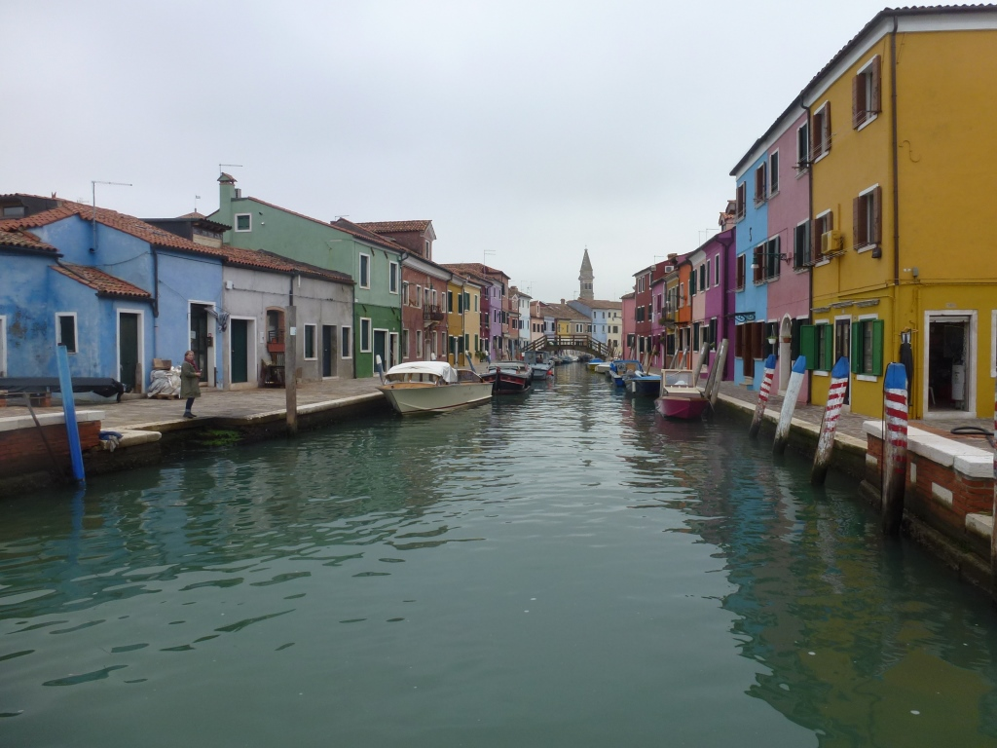
Burano (one of the populated islands in the northern lagoon)
Burano © David Anderson

Slide 11
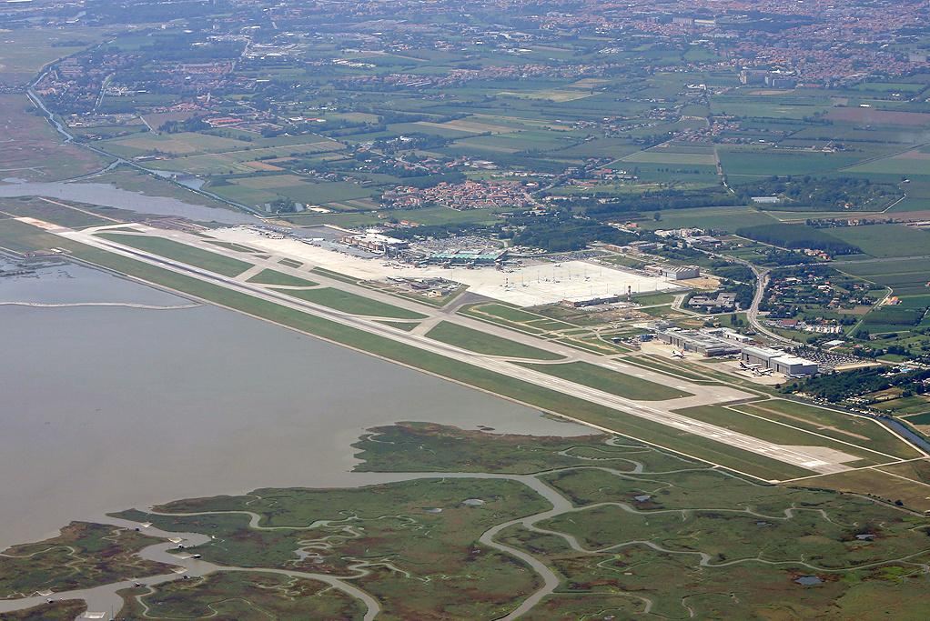
Mestre (mainland settlement) is
located WSW of the airport
Venice Marco Polo airport
Lagoon
Marco Polo Airport © Wikimedia Commons
Salt marsh

Slide 12
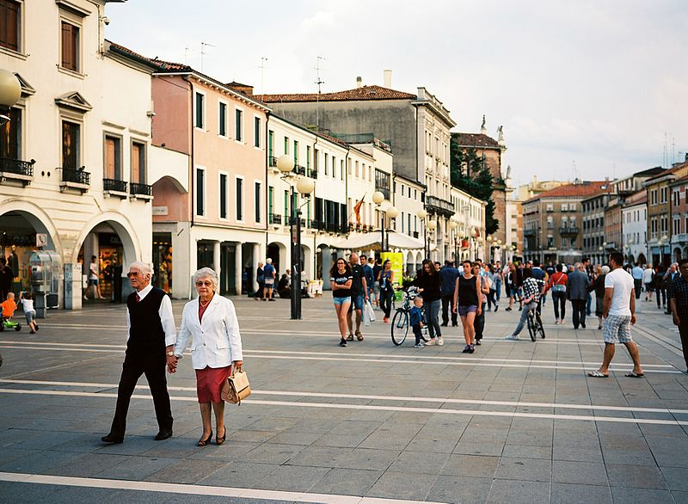
Piazza Ferretto in Mestre (mainland)
Piazza Ferretto in Mestre © William Kimmerle, Wikimedia Commons

Slide 13
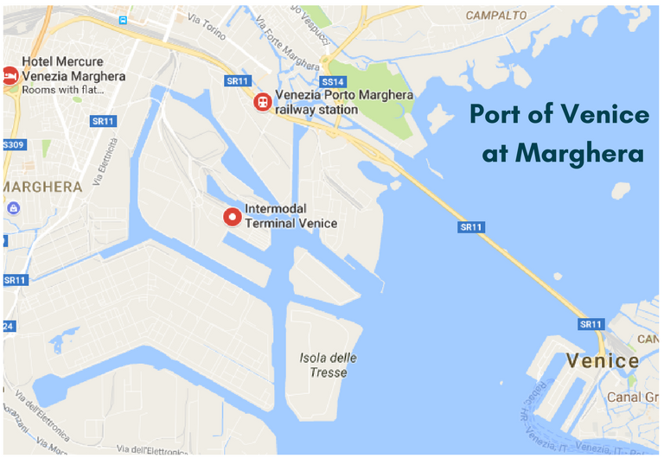
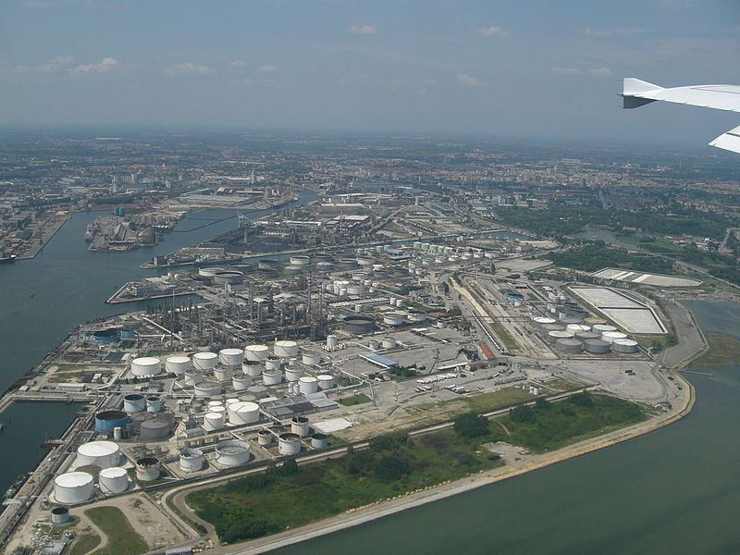
Port of Venice at Marghera
© Google maps
Port of Venice at Marghera © Wikimedia Commons

Slide 14
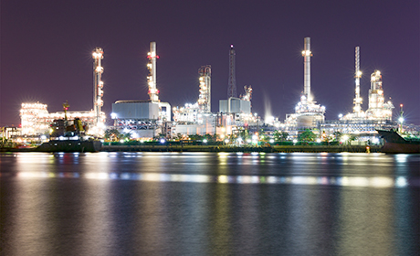
Marghera refinery
Marghera refinery © Wikimedia Commons

Slide 15
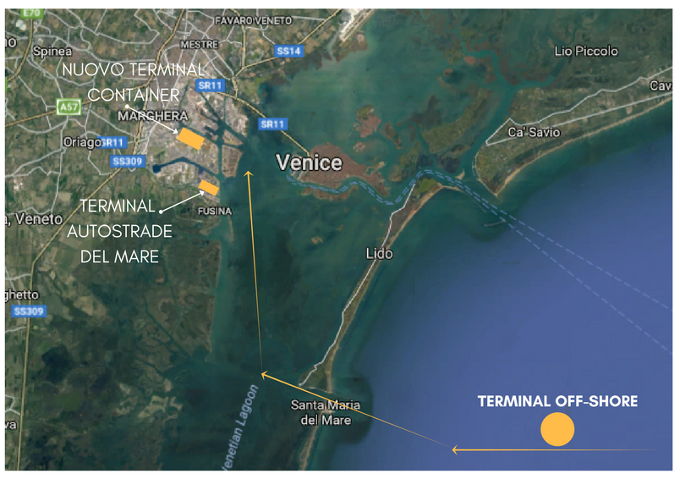
Route for container shipping
© Google maps

