Slide 1
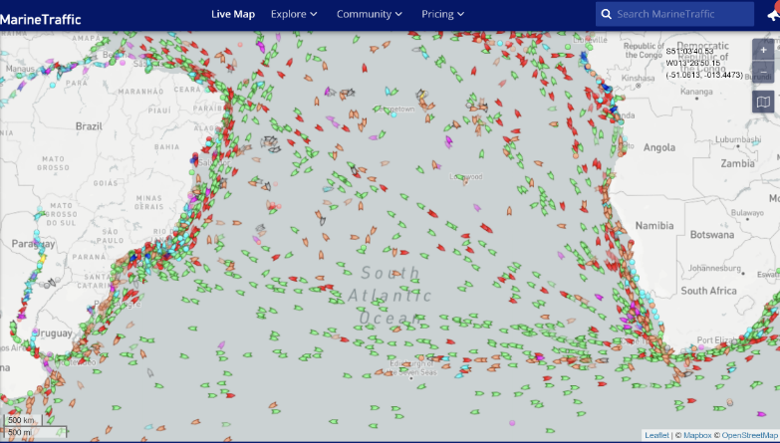
Parallel Lives: maps and GIS
Dan Snow is two days into his expedition on the Agulhas II. He left Cape Town 5th February 2022
Where is Cape Town?
Where do you think his ship is on this map?
What does this map of shipping activity tell you?
07.02.2022
12:40 GMT
MarineTraffic: Global Ship Tracking Intelligence | AIS Marine Traffic

Slide 2
The Story So Far…
The story so far in brief…
In 1914 the explorer Sir Ernest Shackleton set out on an ambitious expedition to cross the continent of Antarctica from one side to the other. He failed. However he achieved one of the greatest feats of turn of the century polar exploration; he returned with all his 27 men – alive, despite the loss of his ship. Shackleton’s ship, the Endurance, was crushed and sank in ice in the Weddell Sea, before his team could even begin that ill-fated attempt to cross the hostile continent of Antarctica.
Find out more here Royal Geographical Society - Geography resources for teachers (rgs.org)
In 2022, the Centenary of Shackleton’s death, Dan Snow is travelling to Antarctica on board the S.A. Agulhas II, as part of the Endurance22 expedition, in an attempt to locate the missing wreck of Shackleton’s ship. He left Cape Town on Saturday 5th February 2022.
Find out more here Expedition Team - Endurance22

Slide 3
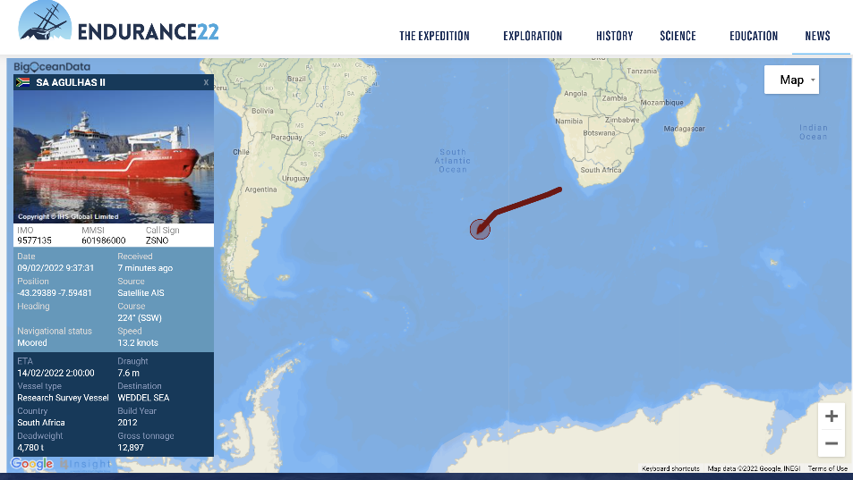
What can maps and GIS tell us?
What does this map show?
When was it last updated?
Where does the information come from?
09.02.2022 09:32 GMT

Slide 4
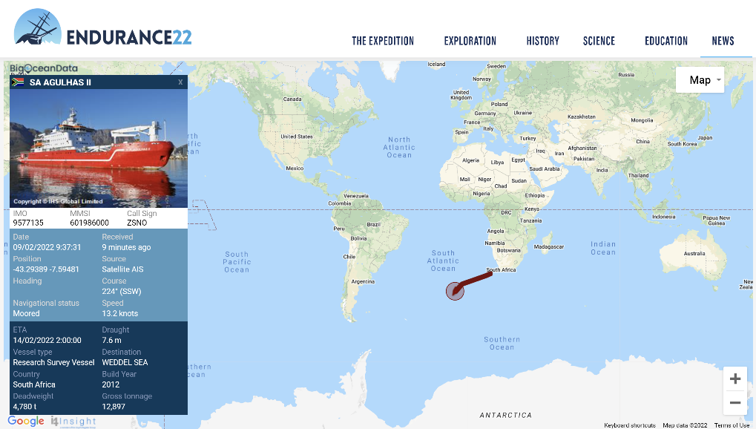
Where in the world?
If we zoom out we can get better sense of where the ship is in the world.
09.02.2022 09:32 GMT

Slide 5
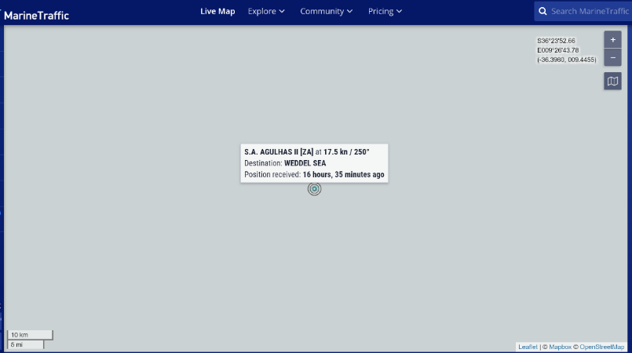
Map Scales? Large or small scale map?
How helpful is this map?
Larger scale maps show a smaller area.
Smaller scale maps show a larger area.
07.02.22
13:56 GMT

Slide 6
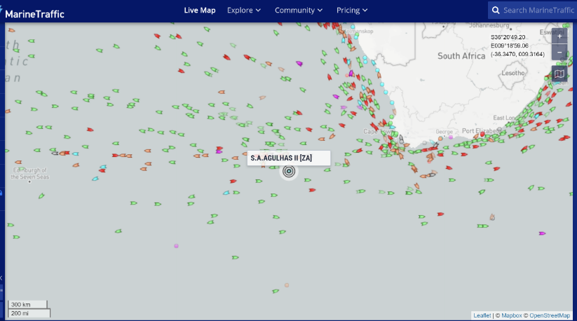
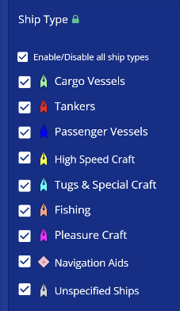
‘Zooming Out’ … How has the scale changed?
How helpful is this map?
07.02.22
14:01 GMT

Slide 7
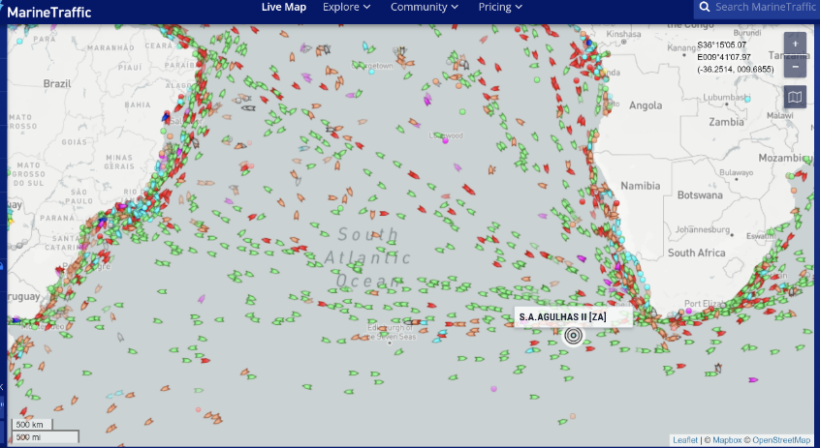
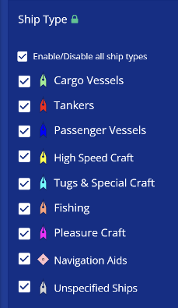
What can we learn from this map?
07.02.22
14:10 GMT
Is this a smaller or larger scaled map? Was the ship where you expected it to be?

Slide 8
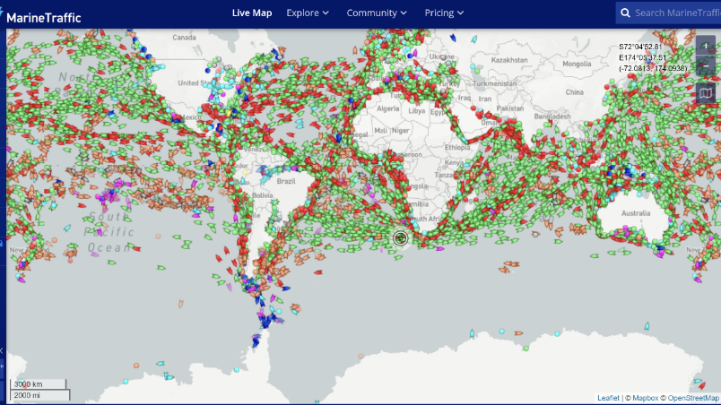
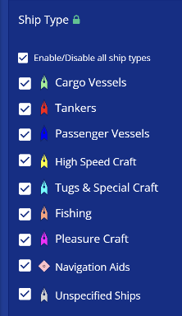
What can we learn from this map?
Large or small scale map?
Where is the Agulhas II?
Where is: Antarctica?
The Weddell Sea?
MarineTraffic: Global Ship Tracking Intelligence | AIS Marine Traffic
Why have we added the date and time to these maps?
07.02.2022 14:35 GMT

Slide 9
How did Shackleton’s expedition navigate?
With no GIS and much of Antarctica unexplored, Shackleton and other explorers had to explore and map out new areas of land by exploring them. They didn’t have digital maps, satellites or GIS to help them. They definitely didn’t have a SAT NAV!
Starting at a known or assumed position, a navigator used simple but reliable tools to track three things:
• The ship’s compass heading.
• The ship’s speed.
• The time spent on each heading and at each speed.
With this information, the navigator could calculate the route and distance the ship had covered and mark a sea chart, if he had one. This method was called dead reckoning. It was used by Columbus and most other mariners of the Age of Exploration.
Dead Reckoning at Sea | Time and Navigation (si.edu)
A good navigator would take measurements of the ship speed and direction and the effects of wind and current too.

Slide 10
Navigation: then and now
Compare mapping sills, tools in Shackleton’s time with now.

Slide 11
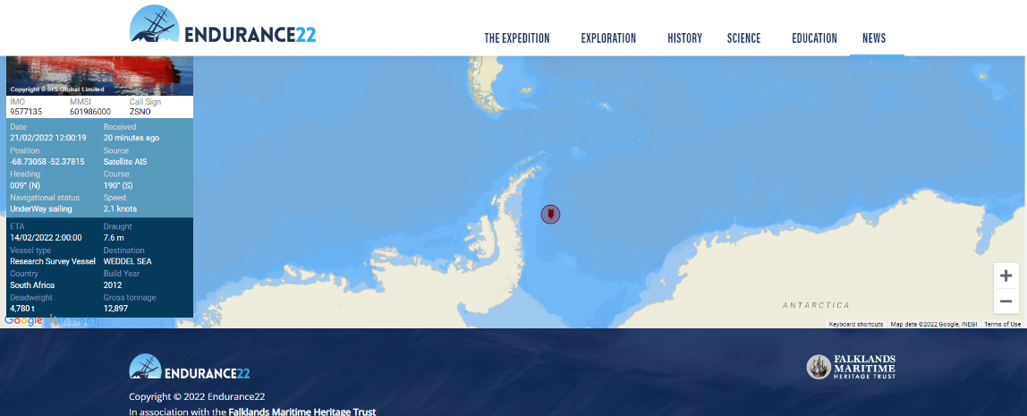
Update Map of position of Agulhas II on 21.02.2022. Source: Endurance22 News - Endurance22

Slide 12
Listen to the podcast from History Hit
Website: Endurance22: The Search for Shackleton's Lost Ship (historyhit.com)
Podcast here: https://play.acast.com/s/c939f8d1-c4bc-478e-8bb9-e5343f9a7ab5/3db94b91-d79f-4725-a967-6bd838b1b6bb

