Slide 1
Stay at Home
Lesson 2
Windows
Paula Owens

Slide 2
Windows
What do we see looking in?
What do we see looking out?
Why did many windows have rainbows or thank you signs in during 2020?
Did you have one in your window?
Do you see any windows that still have signs in?

Slide 3
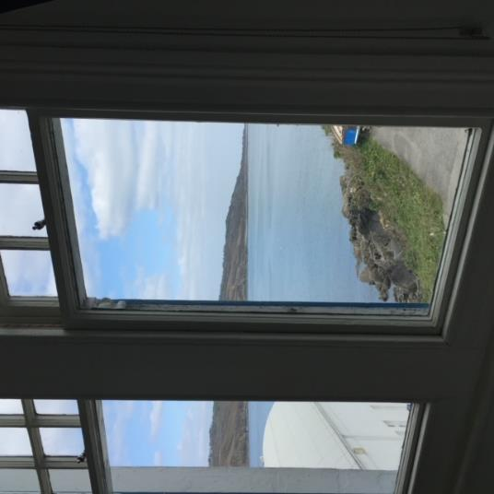
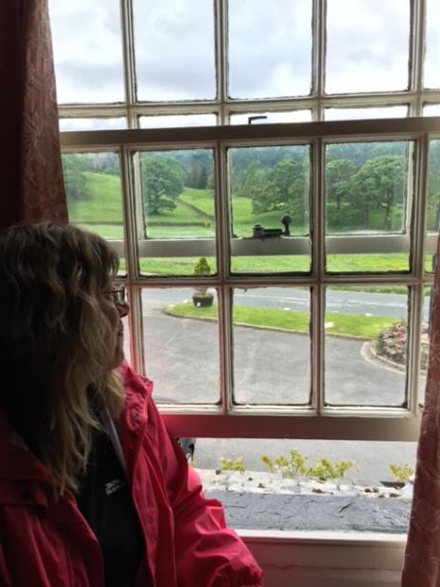
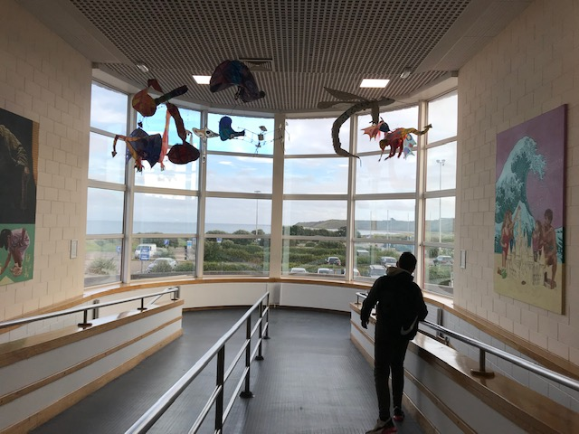
What is the view like from your window?

Slide 4
Starting an enquiry
Where is this window?
What direction does it face?
What can I see?
What human and physical features are there?
What is happening?
What is the weather like?
What can I hear?
What time of day is it?
What day of the week / time of the year is it?
Which window in my house has the best view and why?
Which are the best questions to ask?

Slide 5
Gathering data
Use a compass
Photograph, draw, annotate
Count, graph and map
Film a time lapse
Write a Haiku
What time of day is it busiest?
Can you see a sunrise or sunset from your window*?
Can you ever see the moon from a window?
*Never look directly at the sun

Slide 6
N
I hear and see a lot traffic. The busiest is when I go to school.
Downstairs in my house
Sunniest window
I can see the garden from the patio doors.
See Sketch 1
How will you map your view?

Slide 7
Changing Views
Did you notice changes in the view from your window during the lockdown times?
Wildlife?
Noise?
Traffic?
Litter?
I have also noticed that I can see more birds and hear them singing their songs.
A 10 year old

Slide 8
Changes noticed from my window during lockdown
Traffic
People in my street
Bird song
Children playing outside
How will you present your data?

Slide 9
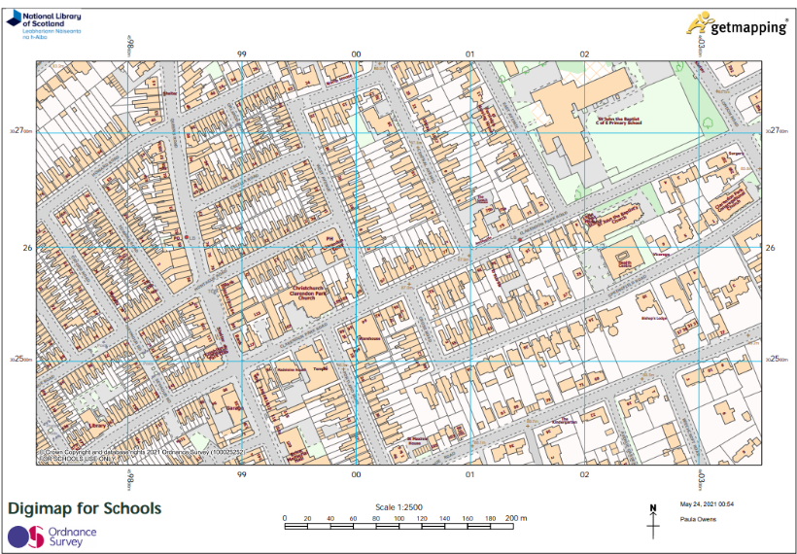
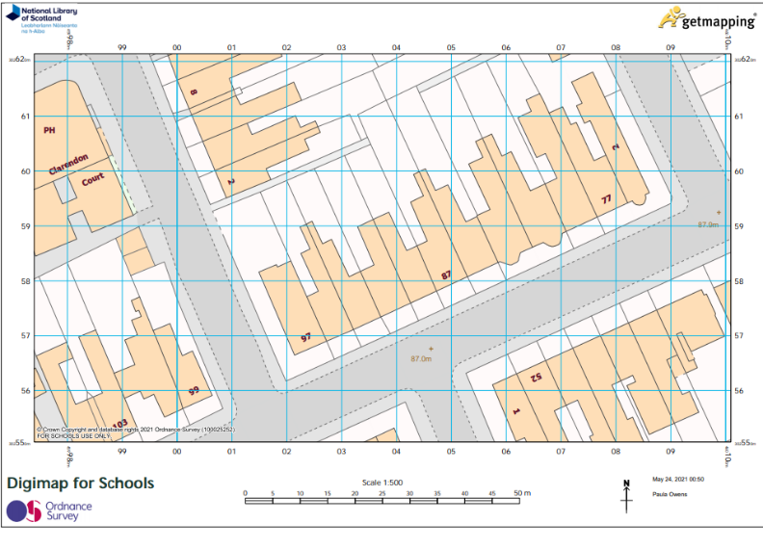
Map your house to show its location. What scale will you select?
www.digimapforschools.edina.ac.uk

Slide 10
Windows
Extension activities

Slide 11
‘Window’ by Jeanne Baker is a popular and favourite book in many classrooms. It has no words but tells a story of development through a sequence of images that shows the changing view over time through the same family’s window.
It can be used with pupils from YR to Y6.

Slide 12
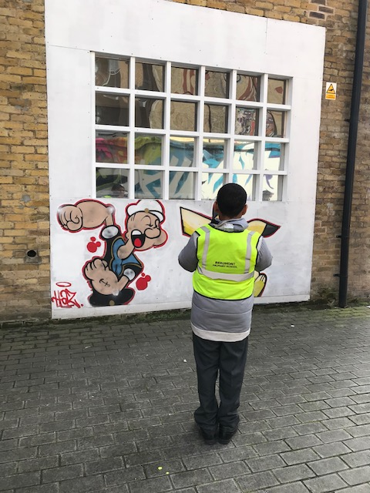
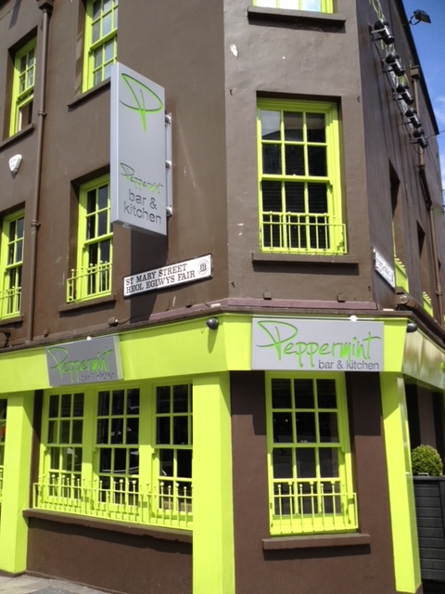
Windows: looking in
Windows come in all shapes and sizes
Sketch the windows of your house
What window shapes do you have in your street?

Slide 13
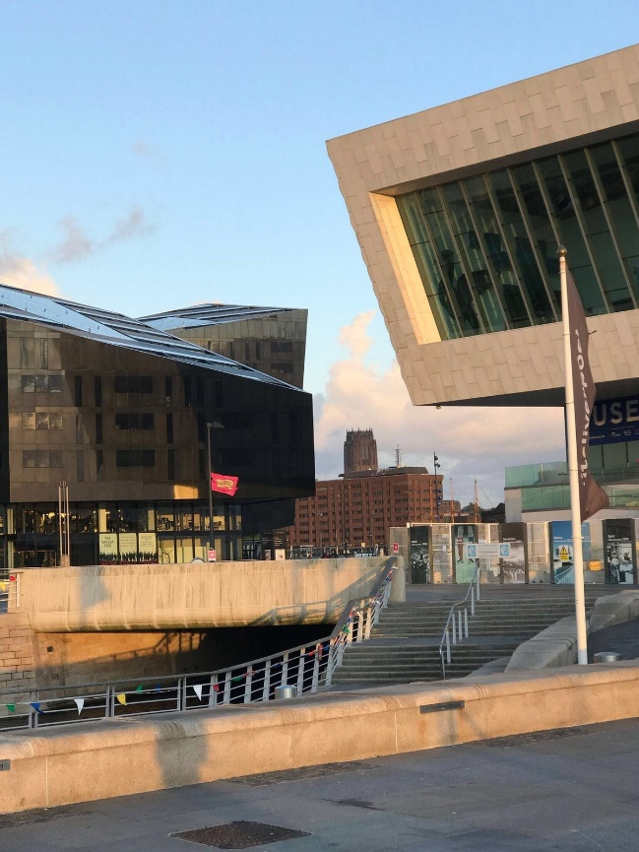
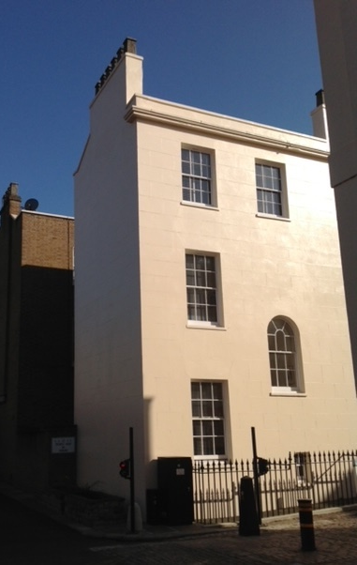
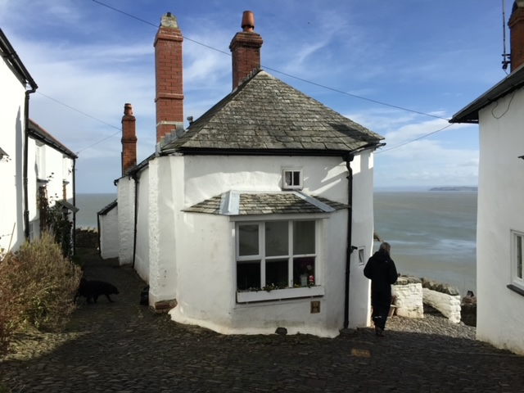
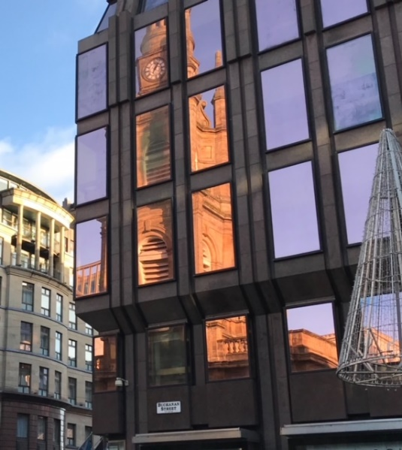
Dublin
Liverpool
London
What interesting buildings and windows do you have in your local area?
Clovelly, Devon
Glasgow

Slide 14
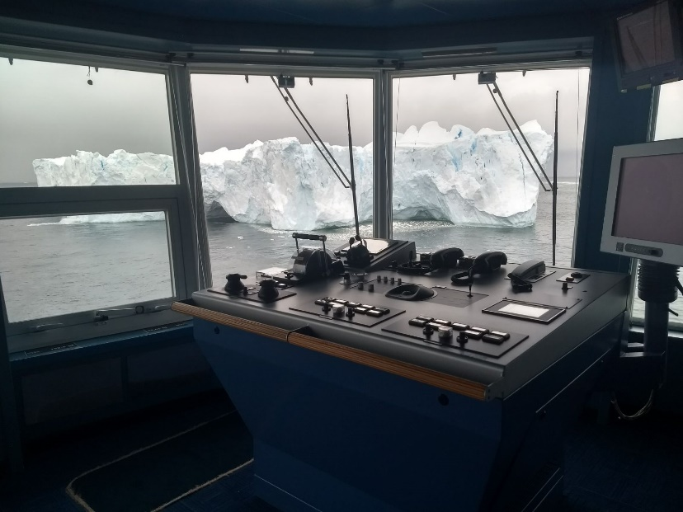
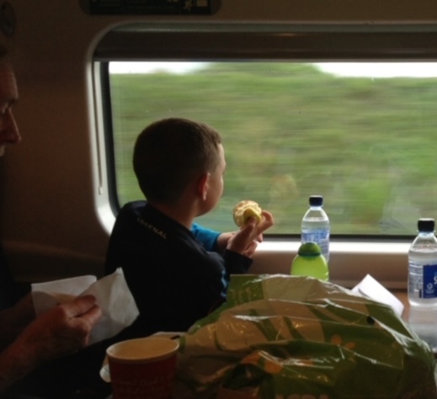
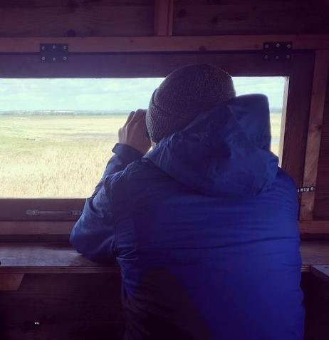
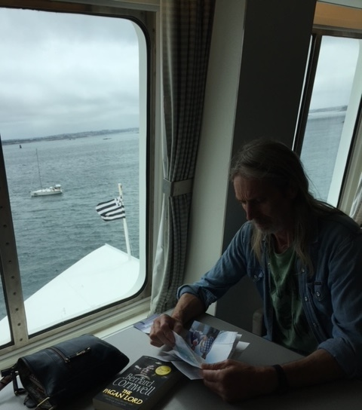
Windows
On a train
A cruise ship near Antarctica
Photograph David Beal
A cross-channel ferry
In a bird hide
Some other examples of windows. Where might you find these?
Make your own collection of interesting windows.

Slide 15
Submit your maps
Please submit your Stay Home maps through www.rgs.org/stayhome –
we are really interested to see what you have created!

