Slide 1
Providing GCSE field work opportunities during COVID and beyond
Hannah Finch Noyes
St Helen & St Katharine School, Abingdon
hfinchnoyes@shsk.org.uk

Slide 2
Context
Unable to complete field work
AQA GCSE
Field work section cancelled
Preparation for A Level
Application of skills

Slide 3
Outline of project
Y11 students – October 2020
3 field work opportunities:
In the field – Rivers OR sustainable urban transport
Remote or in the field – Land use OR environmental quality
Remote – Sustainable water use OR climate change

Slide 4
1. In the field
TWO OPTIONS:
River field work – Velocity measurements
Sustainable urban transport – Traffic counts
FIELD WORK FOCUS:
Hypotheses
Sampling (stratified site choice)
Risk assessment
Evaluation
PLUS – Field work selfies!

Slide 5
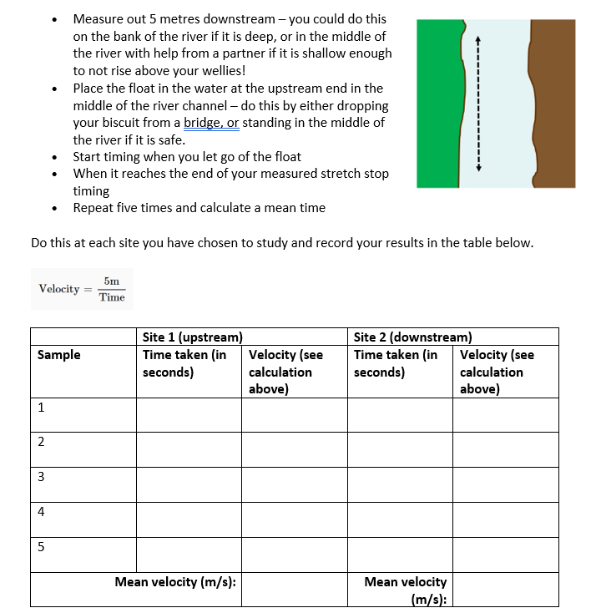

Slide 6
2. In the field or remote
TWO OPTIONS:
Changes in land use in urban areas
Environmental quality in urban areas
FIELD WORK FOCUS:
Hypotheses
Sampling (systematic)
Choosing sites using GIS
Evaluation & conclusion

Slide 7
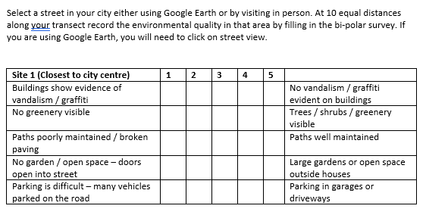
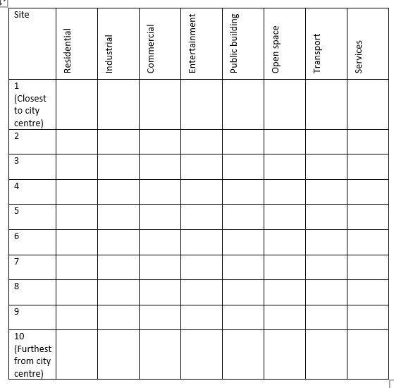
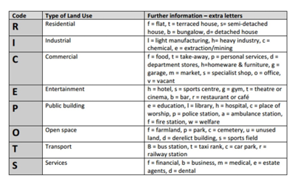
Environmental Quality
Land use
RICEPOTS Land use key

Slide 8
3. Remote
TWO OPTIONS:
Sustainable water use – questionnaire
Climate change mitigation – questionnaire
FIELD WORK FOCUS:
Sampling (choice of sampling strategy)
Hypotheses
Designing questionnaire
Describing results
Explaining results

Slide 9
Evaluation of the Project

Slide 10
Evaluation of the Project
What was your favourite part of the field work experience?
‘My favourite part of taking out fieldwork was going to the river and being put in the fresh air as well as doing fieldwork it was really fun!’
‘Being able to visit different locations’
‘Designing the questionnaire for section C’
‘Going out to the river to measure the velocity, it was fun to do with a friend’
‘I enjoyed most cycling around the city, observing in further detail a city I thought I was very familiar with’

Slide 11
Evaluation of the project
Is there anything you would change about your field work experience?
‘Try and do less online, and find a day with better weather for the river work!’
‘I would make some of the questions in my questionnaire easier to answer by instead of using scales using more yes and no question responses.’
‘The location I did it in’
‘Make it more of a group task e.g. groups of 3/4'

Slide 12
Further comments…
‘Overall I think the fieldwork was easy and straightforward to complete and it helped me develop and understand necessary fieldwork skills.’
‘It was a fun activity to do as it was something different we hadn't done before.’
‘I think that the fieldwork was very good this year particularly because of COVID.’

Slide 13
Next steps…
Y9 preparation for GCSE
Field work as homework
Field work selfies
Choice is key
Get them outside!

