Slide 1
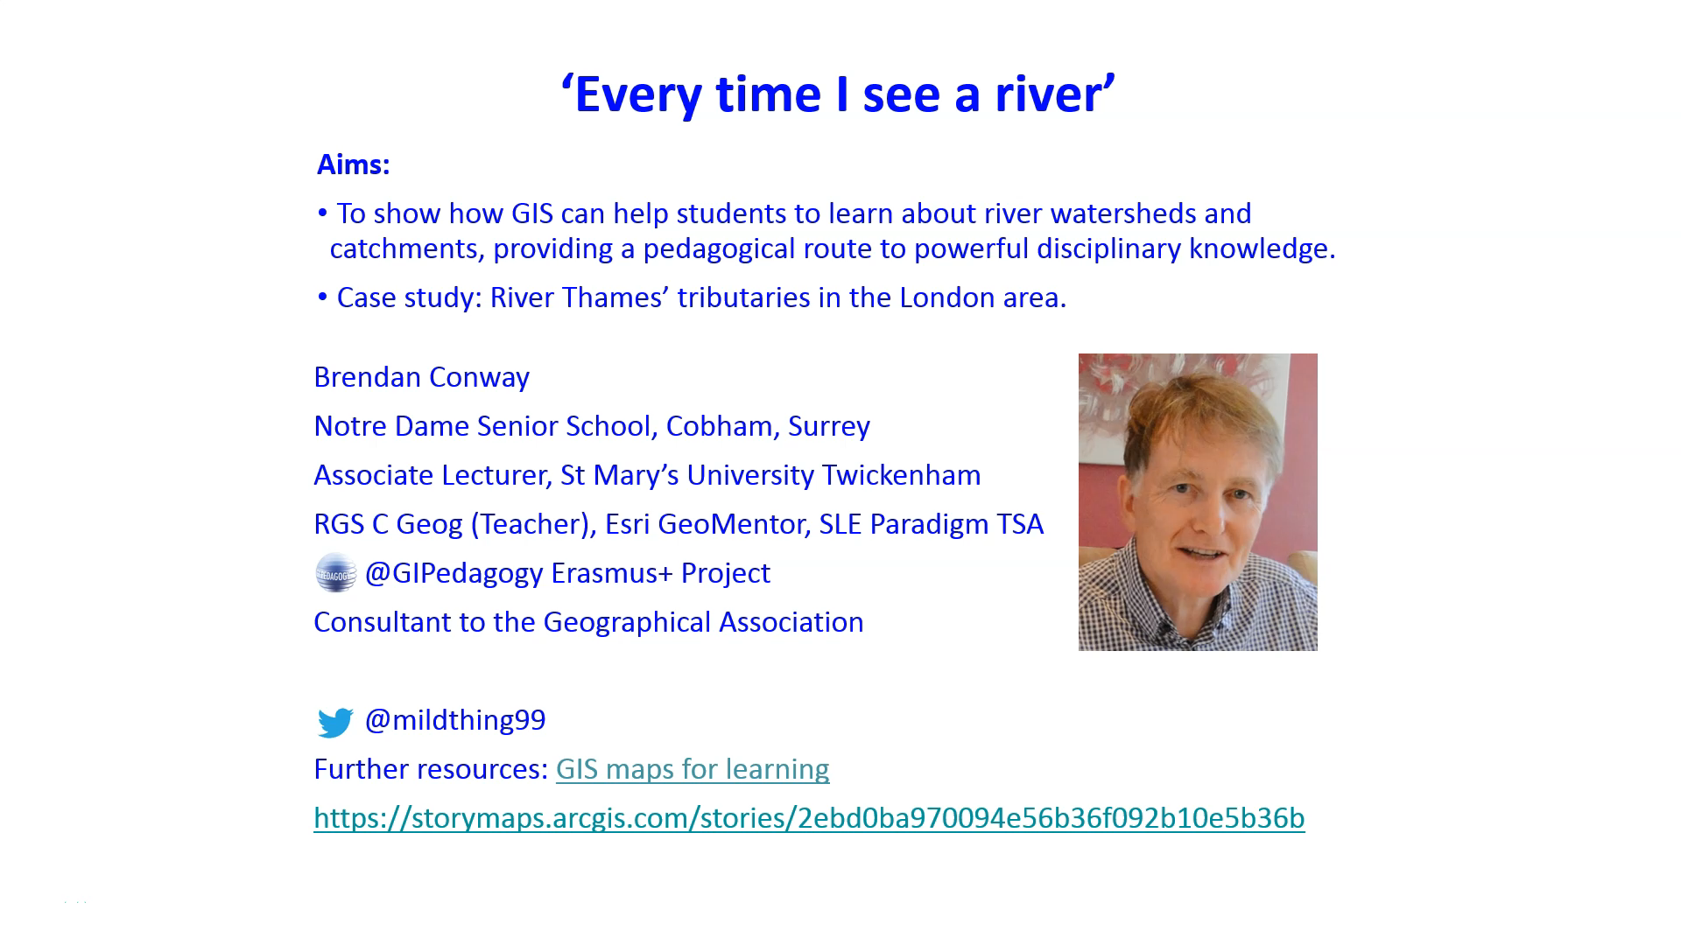

Slide 2
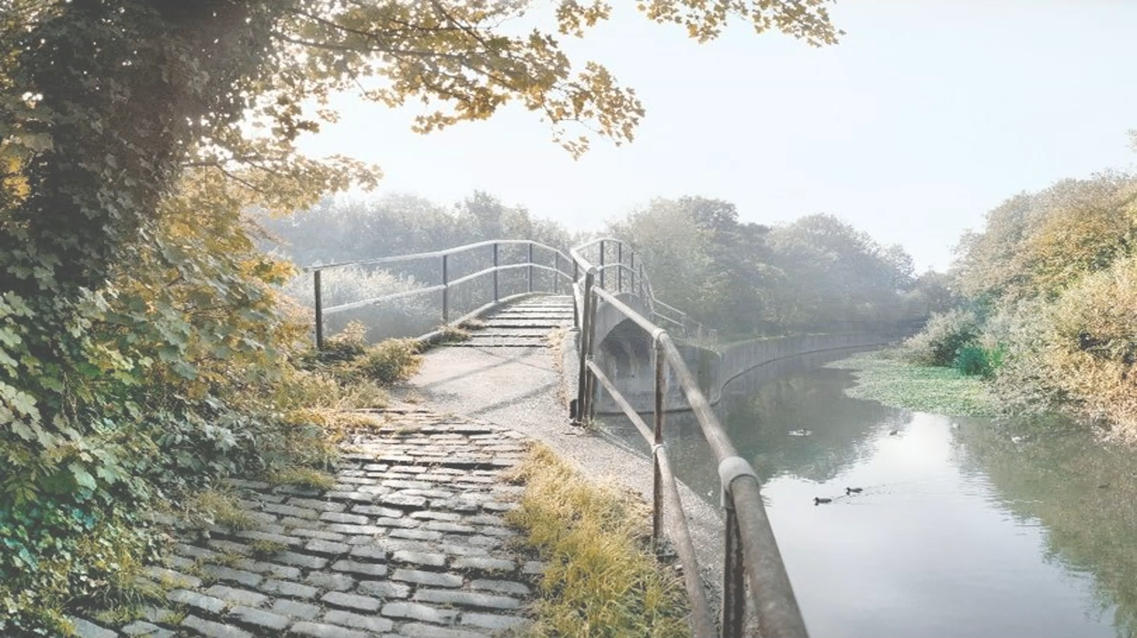
Notes:
Photograph: Museum of London

Slide 3
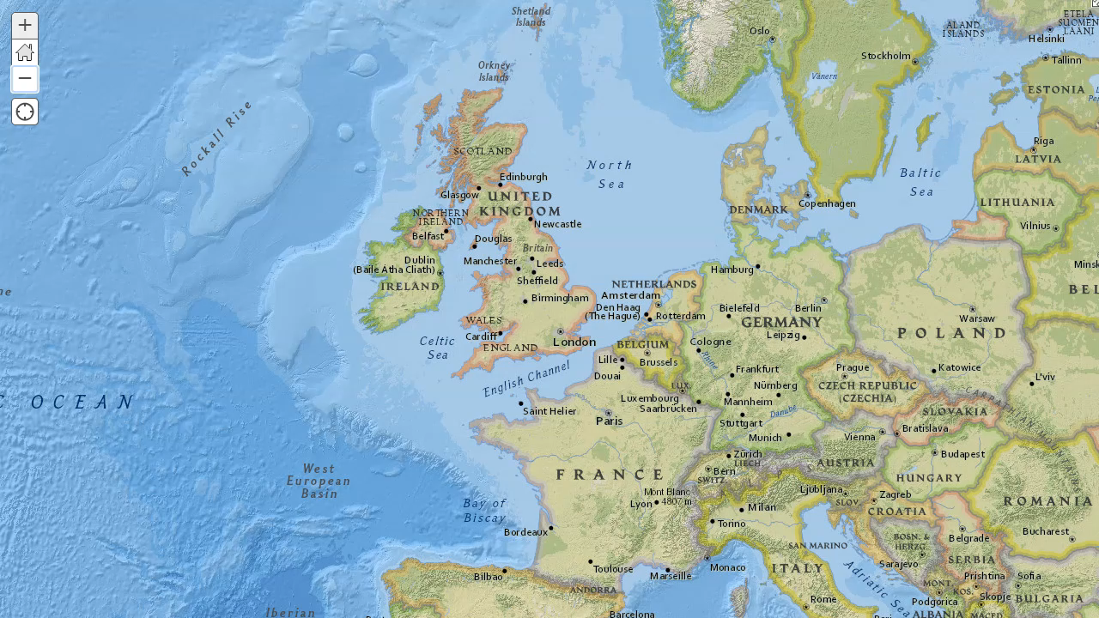

Slide 4
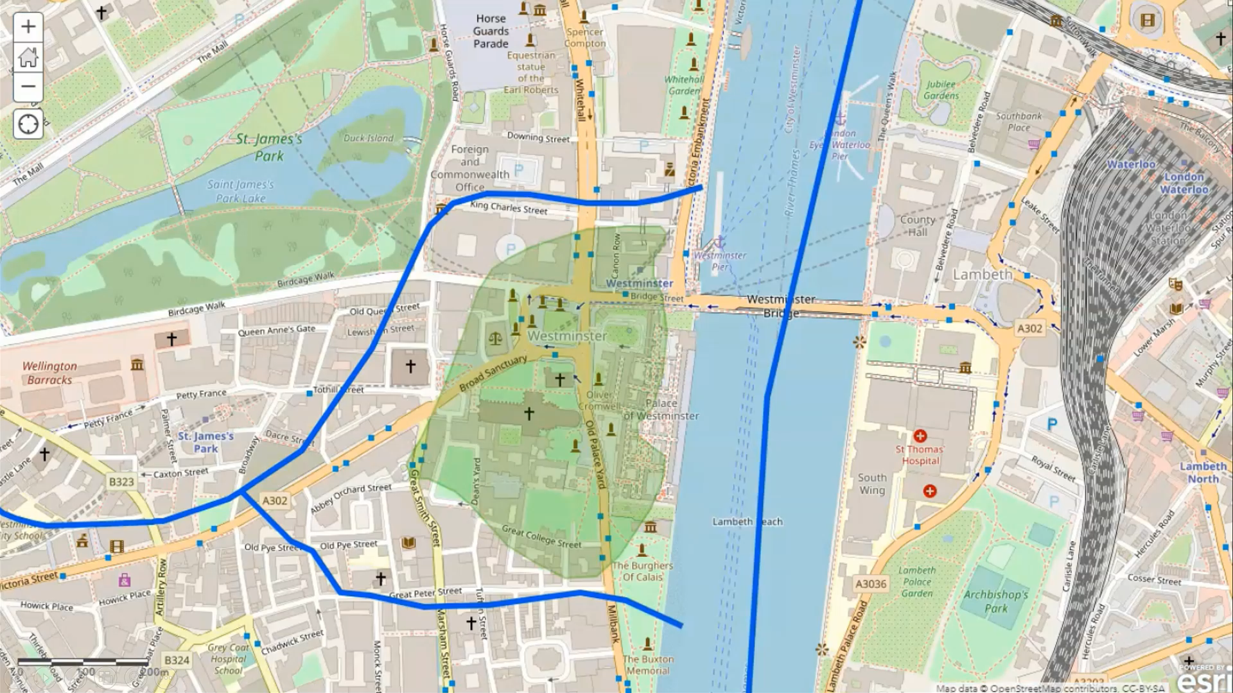
Notes:
IMAGE SOURCES:
Thorney Island #Westminster #London Palace of Westminster and the Abbey environs c1537 in the Reign of King Henry VIII . A bird’s eye view of where the River Tyburn forked to the Thames by Drake Brookshaw after Henderson (Westminster City Archives Centre)
https://twitter.com/oldlondonnow/status/974372245039714304
Image address: https://pbs.twimg.com/media/DYWqZGvXcAEcGYC?format=jpg&name=small
https://www.onlondon.co.uk/vic-keegans-lost-london-103-thorney-island/
Image address: https://www.onlondon.co.uk/wp-content/uploads/2019/08/IMG_6854.jpg

Slide 5
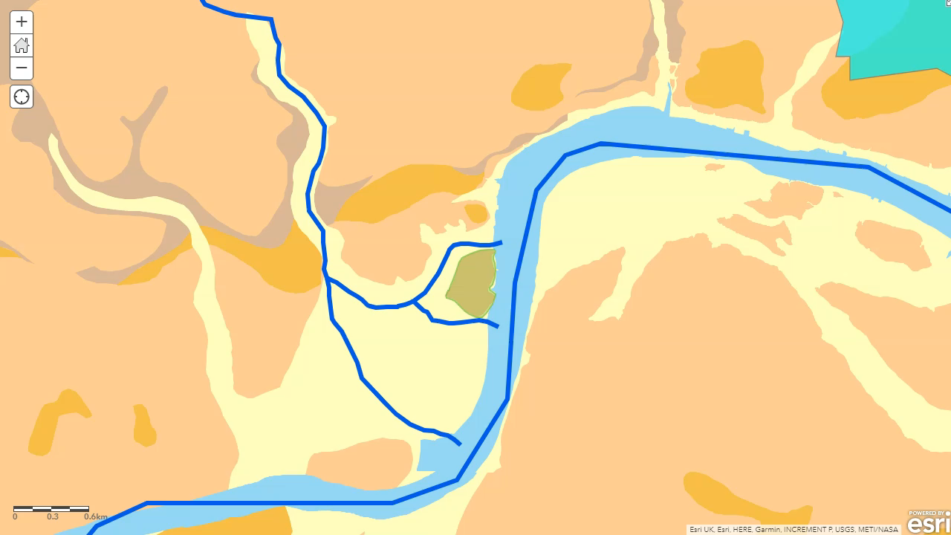

Slide 6
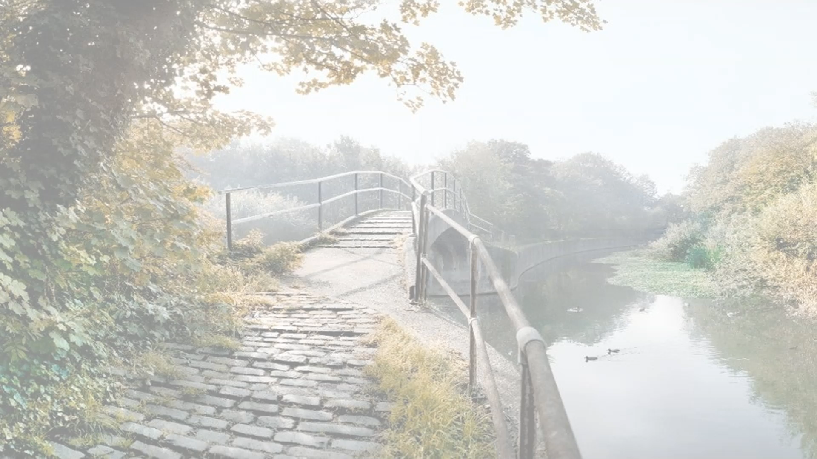
Notes:
Photograph: Museum of London

Slide 7
‘Every time I see a river’: Follow up
How to map a river catchment in ArcGIS Online
A video guide showing how to map a river catchment in this short video recorded for the East London Geography Hub (@EastGeography) River Lea or Le. It also shows how to map a river course and map both catchment and course in 3D Scene.
Dirty old river, must you keep rolling? London’s hidden rivers
Access to web map (as seen in the presentation)
Rivers of London RGS version
File of River Thames catchment mouth (and confluence) points:
River Thames catchment mouth (and confluence) points
‘Every time I see the River Tyburn’
Where to see the River Tyburn storm outlet on Google Maps

