Slide 1
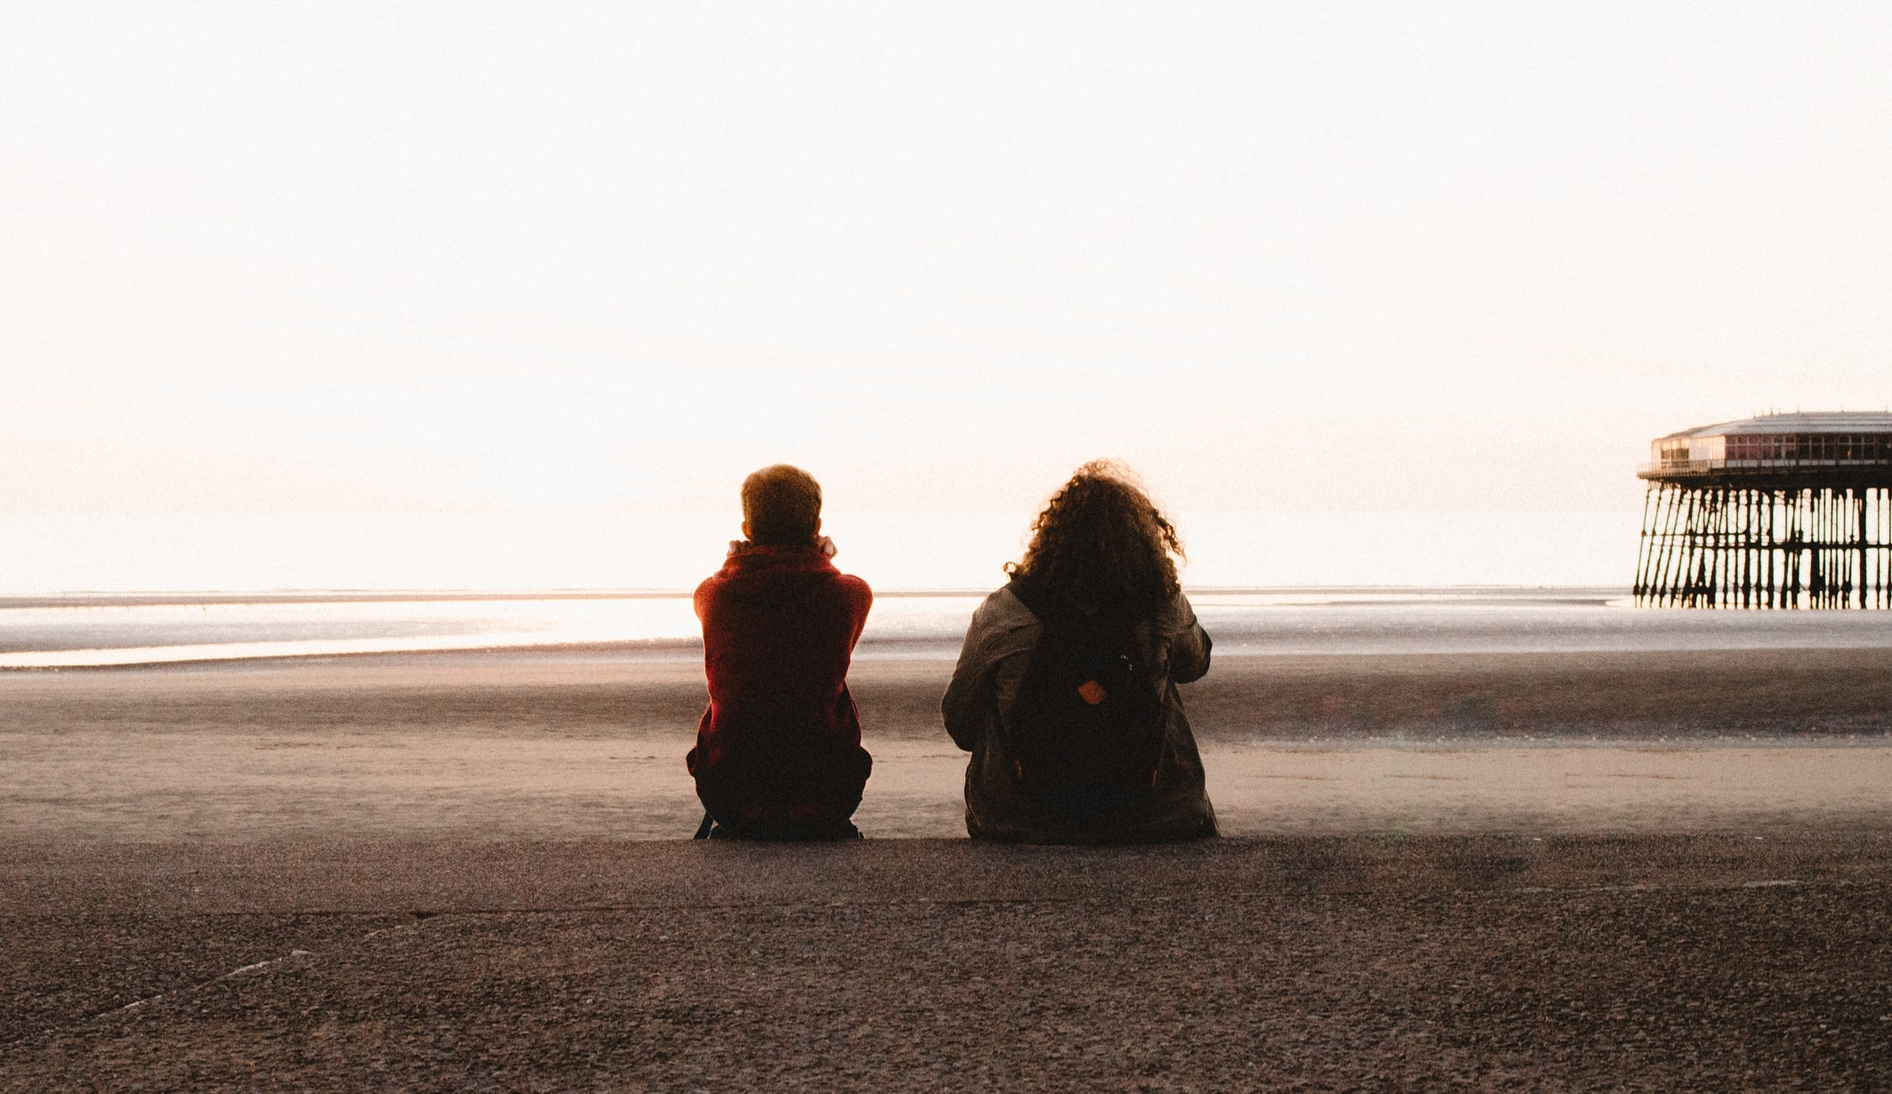
Hopeful Education @HopefulEd
David Alcock – Geography Teacher, Bradford Grammar School
@DavidAlcock1 dga@bradfordgrammar.com www.alcock.blog
Photo: @LukeEllisCraven
Notes:
Hello and thanks for giving me your time this evening.
We all need a dose of hope in these uncertain times, and young people are no exception. I believe that Geography can play a central role in the education we need to allow hope to flourish.

Slide 2
Despair Fear Dread
Doomscrolling Weltschmerz
@HopefulEd
Notes:
Since at least the mid 2010s there has been a discernable turn towards a narrative of despair about the future of the world. Frank Furedi refers to a culture of fear, Bradley Garrett refers to the intangible feelings of dread which have increased through constant assertions of anticipated disasters, and the phenomenon of doomscrolling poignantly describes the act of consuming an endless procession of negative online news. The German word ‘Weltschmerz’ is a great one, covering a feeling of melancholy world-weariness.
Left to a barrage of negativity, our young people may turn off from the world and its wonderful possibilities. What can we do as educators?

Slide 3
Evaluate progress
Believe in humanity
Create a better world
@HopefulEd
Notes:
So what is Hopeful Education? It is a guiding philosophy which aims to help our students...
evaluate progress
believe in humanity
create a better world
The three strands of Hopeful Education are not new: I have been inspired by the likes of Hans, Ola and Anna Rosling from Gapminder/Factfulness, the Our World in Data team, Steven Pinker, Rutger Bregman and many others.
They are not new, but their combination is potentially powerful. My main argument is that we need to look back at the progress we have made, and celebrate the people – and societies - that have made such progress, in order to give our young people the hope that they can create a better world.

Slide 4
Evaluate progress - Hopeful Education encourages learners to engage with and interrogate the notion of progress, understand and explain positive trends, put these gains in the context of regress in other areas, and use this understanding to inform debates about future progress
@HopefulEd
Notes:
Here’s a little more about the three strands before we look at the role of education
Hopeful Education encourages learners to engage with and interrogate the notion of progress, understand and explain positive trends, put these gains in the context of regress in other areas, and use this understanding to inform debates about future progress.

Slide 5
Believe in humanity - Hopeful Education seeks to reaffirm the potential of human nature to work collectively for the common good, whether that be in the classroom, inter-generationally, locally, nationally, or in the context of global governance and co-operation
@HopefulEd
Notes:
Hopeful Education seeks to reaffirm the potential of human nature to work collectively for the common good, whether that be in the classroom, inter-generationally, locally, nationally, or in the context of global governance and co-operation.

Slide 6
Create a better world – Hopeful Education champions and facilitates futures thinking and education for sustainable development
@HopefulEd
Notes:
Hopeful Education champions and facilitates futures thinking and education for sustainable development. I agree with David Hicks that futures education has been neglected and should be a core aspect of geography and education as a whole.

Slide 7
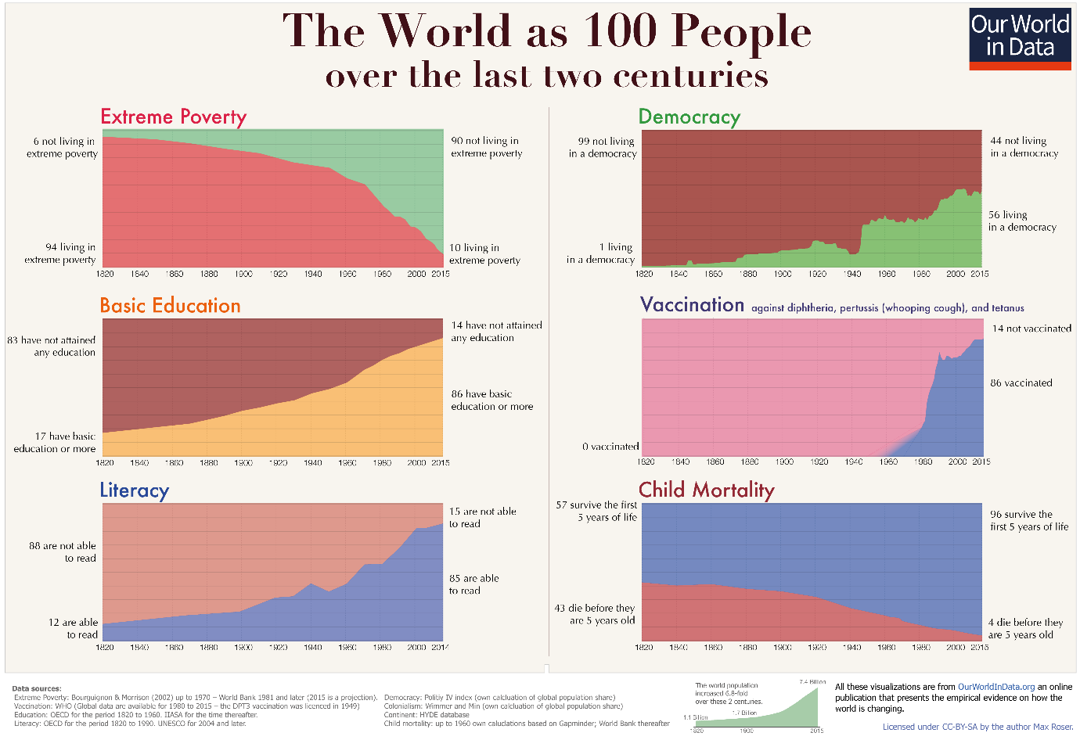
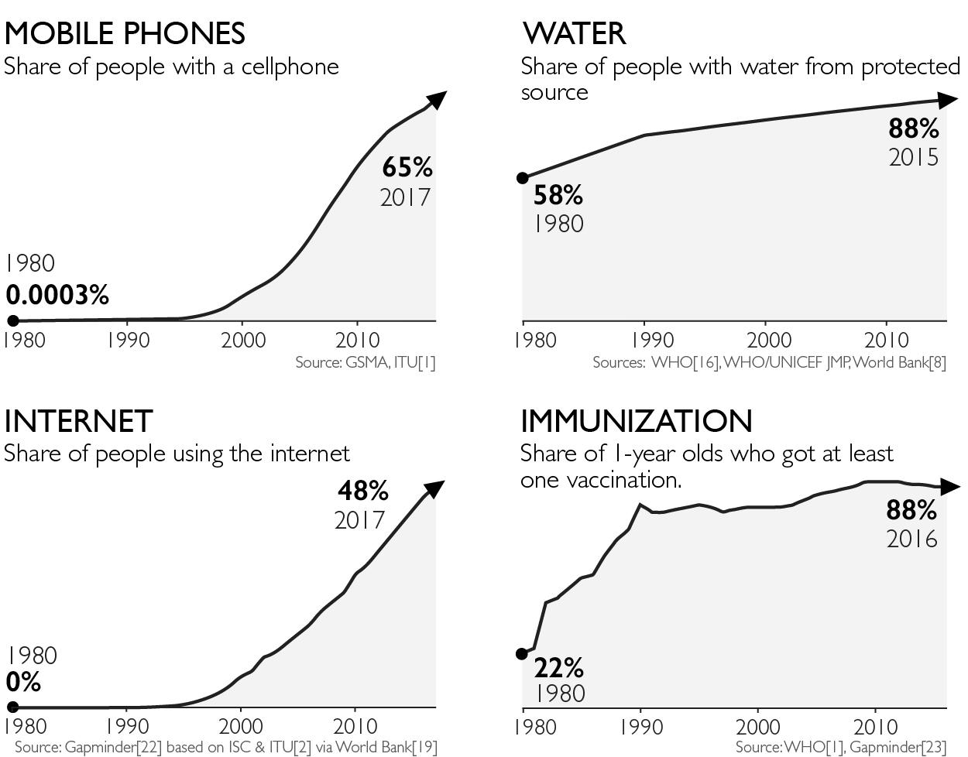
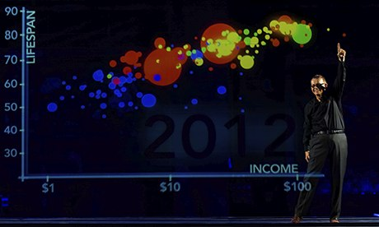
Sources:
https://ourworldindata.org/wp-content/uploads/2017/01/Two-centuries-World-as-100-people.png
Full references in Factfulness
Notes:
As Geography teachers, we should all be familiar with these graphs from Factfulness and OurWorldinData showing the wide range of ways in which most people’s lives have improved from being ‘nasty, brutish, and short’ – humanity is now healthier, better nourished, wealthier, more tolerant, democratic, peaceful, and in many respects greener, than it was at the start of the Anthropocene. These developments have not come without costs, and immense challenges remain. But how can we build on Hans Rosling’s legacy to instil hope in our young people that we can overcome these challenges?

Slide 8
Trends
Notes:
Well, yes, let’s use Factfulness and Gapminder. But let’s look at other sources too. Do we deeply analyse and evaluate trends often enough? Do we look at positive trends? Challenge your students! Delve into Our World in Data – what are the trends? What might explain them? Might any trends be reversed? What’s missing? This graph under-represents progress, as the world’s population has more than quadrupled since 1900.

Slide 9
Branching timeline
Preferable future
Source: adapted from Hutchinson (1996) and Hicks (2007)
Current situation
Feared future
@HopefulEd
Notes:
We should also take a leaf out of futures teaching and look at alternative futures, to give young people hope that they have the agency to act, campaign, and vote, to move towards a preferable future. Start by asking them to note their fears in the bottom right, then return to the top right after they have studied trends and campaigns.

Slide 10
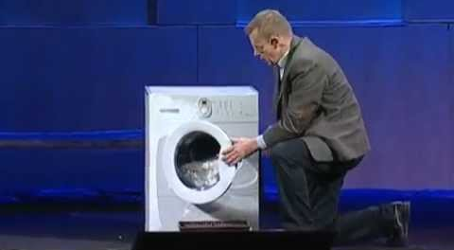
The magic washing machine
What has been the greatest achievement of humanity?
Gather ideas, then show this video: www.youtube.com/watch?v=BZoKfap4g4w
Concept map
How are these linked?
INDUSTRIALISATION
LITERACY
HUMAN RIGHTS
CLIMATE CHANGE
ENERGY
POLLUTION... etc
Source: inspired by Rosling (2011)
@HopefulEd
Notes:
The first activity alone should boost students’ confidence in the achievements of humanity.
This emotional video features Hans recalling how his grandmother used a washing machine then said ‘and now we can go to the library’.
Technology can be demonised, but it can liberate.
Ask students to explain some of their connections.
Then ask them how their attitude towards industry and industrialisation might have changed. What might affect the way they think about progress? Do they have any other candidates for the greatest achievement of humanity?

Slide 11
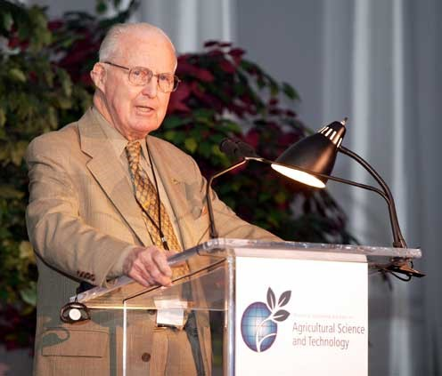
Standing on the shoulders of giants
@HopefulEd
Notes:
Who is this?

Slide 12
Standing on the shoulders of giants
Giant | Breakthrough | Lives Saved
Borlaug | Green Revolution | >1 billion
Landsteiner | Blood Groups | >1 billion
Wolman and Enslow | Chlorination of Water | >177 million
Jenner / Foege / WHO | Smallpox | N/A (It killed 300m in 20thC)
NB All of us have a chance to play our part – to stand on the shoulders of giants
Source: inspired by Pinker (2018)
@HopefulEd
Notes:
It was Norman Borlaug, father of the Green Revolution, the selective plant breeding scheme – Miracle Rice and the like - which saved 1 billion people from starvation.
Personal stories can hook students in, and should be used in the geography of health, human rights and technology.
Card sorting which giants we are standing on, and which giants they are standing on, might restore faith in humanity.

Slide 13
Future Histories
The end of slavery. Votes for women. The end of apartheid. A treaty to close the gap in the ozone layer. The eradication of polio from Africa. The internet. How did these things happen?
Now imagine it’s the year 2100. How did these things happen?:
Control of climate change
The end of plastic pollution in the seas
The end of the tobacco industry
The end of gender inequality
The end of racial inequality
The end of extreme poverty
The end of pandemics
Source: adapted from Hutchinson (1996); informed by F Harvey (2020) →
Notes:
You could ask students: If you lived 400 years ago, would you have foreseen the end of slavery? If you lived 120 years ago, would you have foreseen votes for women?
35 years ago, many people couldn’t have foreseen the end of apartheid, a global treaty to close the gap in the ozone layer, and the eradication of polio from Africa, let alone smartphones and the internet! How did these things happen? Refer to a combination of individual action, pressure groups and government and other actions... Stress the importance of international collaboration, public bodies, and civil society.
Ask students to put themselves 80 years in the future – in 2100 – and envisage a history of how one or more of these events happened:
Control of climate change
The end of plastic pollution in the seas
The end of the tobacco industry
The end of gender inequality
The end of racial inequality
The end of extreme poverty
The end of pandemics
There is a recent podcast and article in the Guardian about how the green movement can take hope from previous wins.
https://www.theguardian.com/environment/2020/oct/12/climate-crisis-campaigns-pledge-real-change

Slide 14
Challenges
Hasn’t it been done before?
‘Education of hope’ / Futures education
Factfulness / Gapminder
Education for Sustainable Development
Should teachers promote Hopeful Education?
Greta Thunberg: “I don’t want your hope”
False hope?
Complacency?
Role of education
If we do take it on, how do we do it?
Pastoral / academic?
Geography / cross-curricular?
Guiding vision / separate unit?
Standalone session?
@HopefulEd
Notes:
Hasn’t it been done before? – In disparate elements, yes, but not as a syncretic whole.
Should teachers promote Hopeful Education? Greta Thunberg said “I don’t want your hope. I don’t want you to be hopeful. I want you to panic. I want you to feel the fear I feel every day, and then I want you to act” – so, is hope a burden?
In Clockwise, the headmaster says “I don’t mind the despair – it’s the hope I can’t stand”!
But hope is better than despair; hope does drive action.
If we do take it on, how do we do it?
So many things to discuss. At my school we are holding a standalone Hopeful Education day for Year 10s on 8 December. Watch this space!

Slide 15
Interested?
Tonight:
Follow @HopefulEd and DM your email address
Read the top post on www.alcock.blog
Tomorrow:
@GeogChat, 1930-2000 – Three questions:
What activities do you do which give your students hope for the future?
How and when do you refer to humans working collectively for the common good?
What role could/should Geography take in promoting a more hopeful education?
Find out more:
May 2019 Impact Journal: ‘An Optimistic Education’
Autumn 2019 GA Teaching Geography: ‘Optimism, progress and geography – celebration and calibration’
November 2020 Geography Review: ‘Challenging your world view’
Upcoming: GA CPD pack and online lesson resource
2021 GA Conference: Lecture Plus and Panel Discussion
2021/2: Resource pack / whole year group session plans / conference?
Plenty of material by David Hicks, Gapminder, Steven Pinker and so on!
Thank you for listening! David

Slide 16
Hopeful Education @HopefulEd
David Alcock – Geography Teacher, Bradford Grammar School
@DavidAlcock1 dga@bradfordgrammar.com www.alcock.blog
Photo: @LukeEllisCraven

